Slide 1
Executive
Seminar on
Building a
Corporate
Intelligence
Agency (CIA)
with Ultra AI
Stop
Business IP
Espionage &
Sabotage Now
October 2021 Update
Developed and Delivered by Thomas B. Cross
CEO TECHtionary.com
cross@gocross.com 303-594-1694
© TECHtionary.com

Slide 2
Business Espionage & Sabotage
Seminar on
Building Corporate Intelligence Agency (CIA)
“The enemy have this time prevented us from knowing enough about them; but we have not prevented them from knowing far too much about us.”
Business Espionage & Sabotage
Seminar on
Building Corporate Intelligence Agency (CIA)
“The enemy have this time prevented us from knowing enough about them; but we have not prevented them from knowing far too much about us.”

Slide 3
If you have questions, please email them to:
cross@gocross or call 303-594-1694
Background, references and more at the end.
© TECHtionary.com

Slide 4
Webinars - Road Rules
I don’t have all the answers or know it all or what Bill Gates has planned other than world domination
Nor do I have “psychic” abilities, if I did I would have bought Microsoft in 86’ and would now be living in Tahiti.
If you don’t mind, please save questions for breaks, however, write your question down NOW, it may be answered later in this presentation and so we can incorporate your question in later presentations and this allows for personal attention to your needs. Or, glad to answer any questions during the break, lunch or at the end of the day.
At the same time, brief contributions are welcomed.
My commitment to you is to help you jobs.
Or looking at it another way, this is about bungie jumping, not bungie jumping.
The “CREB” approach.
Oh, my job is to speak, your job is to listen, if you get done before me you are free to go out to play.
Or, looking at it another way, you can read 5 times faster than I can speak and I’m counting on that.
© TECHtionary.com

Slide 5
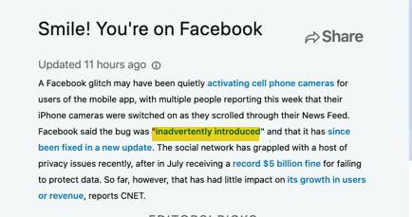
Key PointS – WHY Build a Corporate Intelligence Agency
You cannot predict competitive, hack attacks either in M&A, advances in tech or anything else, nor react to them, you can only direct customers to your content and thought leadership.
© TECHtionary.com

Slide 6
Corporate Intelligence Agency – RESULTS
“The lack of a centralized corporate intelligence agency resulted in some strategic market and product failures of monumental proportions. This course got our thinking organized and the foundation of a really cool concept.” S.A. CEO
“AI was tossed around like a “cure-all” for all our problems but we really didn’t understand what we needed to do. Finally, we understand how we can use AI to respond faster to our competition and we are finally starting to beat them.” J.K. CFO
© TECHtionary.com

Slide 7
6 Key PointS – WHY Build a Corporate Intelligence Agency (CIA)
1 - Tracking - KTO-keep track of it all
2 - Technology
3 - Tasks – Ahead, Behind and looking into the Sand
4 - Terrorism - External and Internal
5 – TEAM – CEO As CRO – Chief Reputation Officer
6 - Trends - Direct, not predict or react

Slide 8
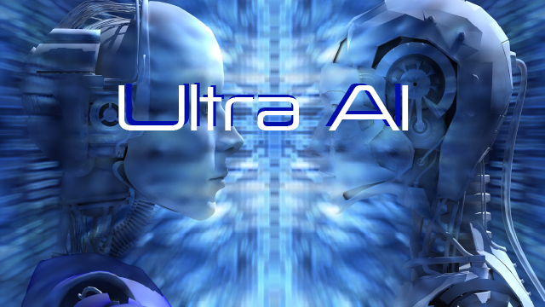
Key PointS – WHY Build a Corporate Intelligence Agency
Build your own Ultra AI system, for example as one CEO said “Ultra would have told us that …competitors have this time prevented us from knowing enough about them; but we have not prevented them from knowing far too much about us.”
https://futurism.com/the-byte/russian-startup-selling-robot-clones-real-paper
© TECHtionary.com

Slide 9
1 - Tracking - KTO-keep track of it all
Realize your management is the most significant cause for intelligence leaks. As was found one organization found “No need for its own intelligence department, and which deemed it an affront to its own intelligence strategy to allow its own strategic decisions to be influenced by what others might or might not be doing.”
https://books.apple.com/us/book/the-secret-war/id1031472452
© TECHtionary.com

Slide 10
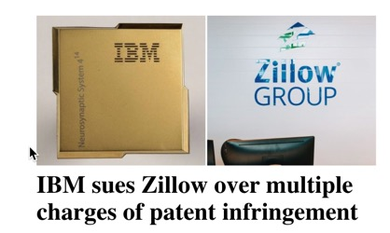
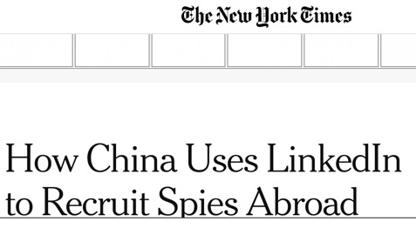
https://www.digitaltrends.com/social-media/linkedin-reportedly-used-by-some-nations-to-recruit-spies/
https://www.nytimes.com/2019/08/27/world/asia/china-linkedin-spies.html
© TECHtionary.com

Slide 11
1 - Tracking - KTO-keep track of it all
Start with listening:
Global issues
Emerging trends
Industry outlook
Events and speaking
Competitive insights
Toxic media
© TECHtionary.com

Slide 12
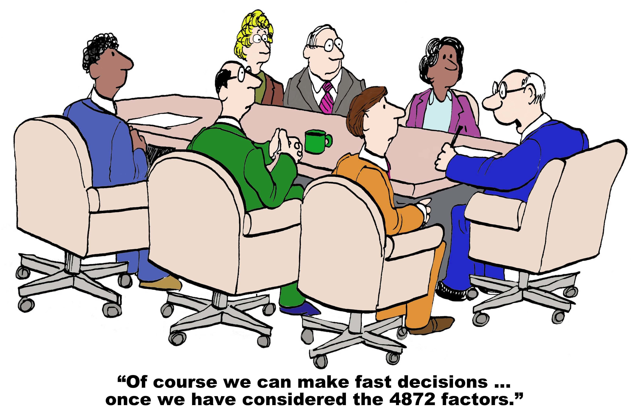
1 - Tracking - KTO-keep track of it all
Changing demographics
Data diving into CRM
Mining marketing tools
Thinking automation will cure results
© TECHtionary.com

Slide 13
1 - Tracking - KTO-keep track of it all
Research and analyze your own customer internal and external content messaging. For example, an increasing number of CEO’s are involved in company message to talk publicly to all stakeholders with their own message bypassing corporate communications and most importantly corporate gossip channels adding transparency, bringing closeness and clarity to the issues at hand but at a significant risk of competitive analysis and response.
© TECHtionary.com

Slide 14
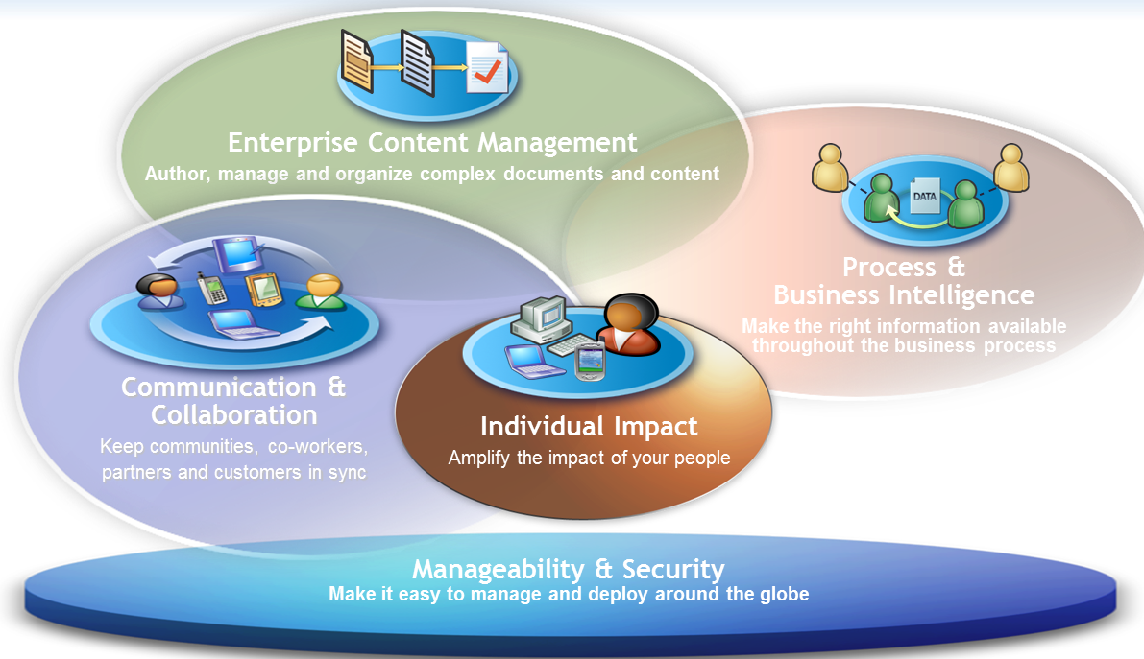
1 - Tracking - KTO-keep track of it all
Remember the majority of cyber attacks come from disgruntled or dishonest employees, so the likelihood of the crisis coming from within is very high.
Monitor and track internal communications, support “whistle-blowers” and reward for “see something, say something” efforts and continuous company communications.
© TECHtionary.com

Slide 15
1 - Tracking - KTO-keep track of it all
© TECHtionary.com

Slide 16
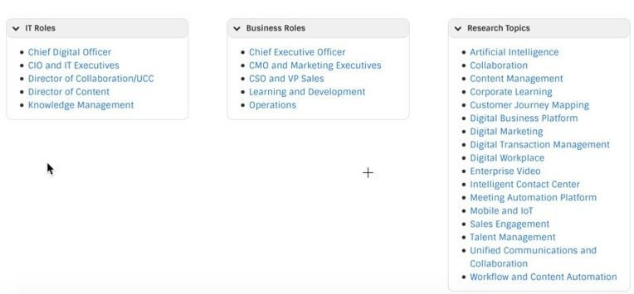
1 - Tracking - KTO-keep track of it all
What are competitors doing that you are not.
© TECHtionary.com

Slide 17
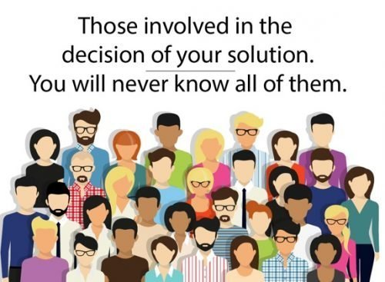
1 - Tracking - KTO-keep track of it all
Quantify Customer type:
Strategic/Major
Geo/Demographic
Large/Small Business
Vertical
Channel/VAR/SI
Industry
Technology
Family
Advisor
Legal/Acct
- Specialty
Distribution
OEM
White Label
Executive
Street - Farmers
Food truck
Event
Home/Gig
© TECHtionary.com

Slide 18
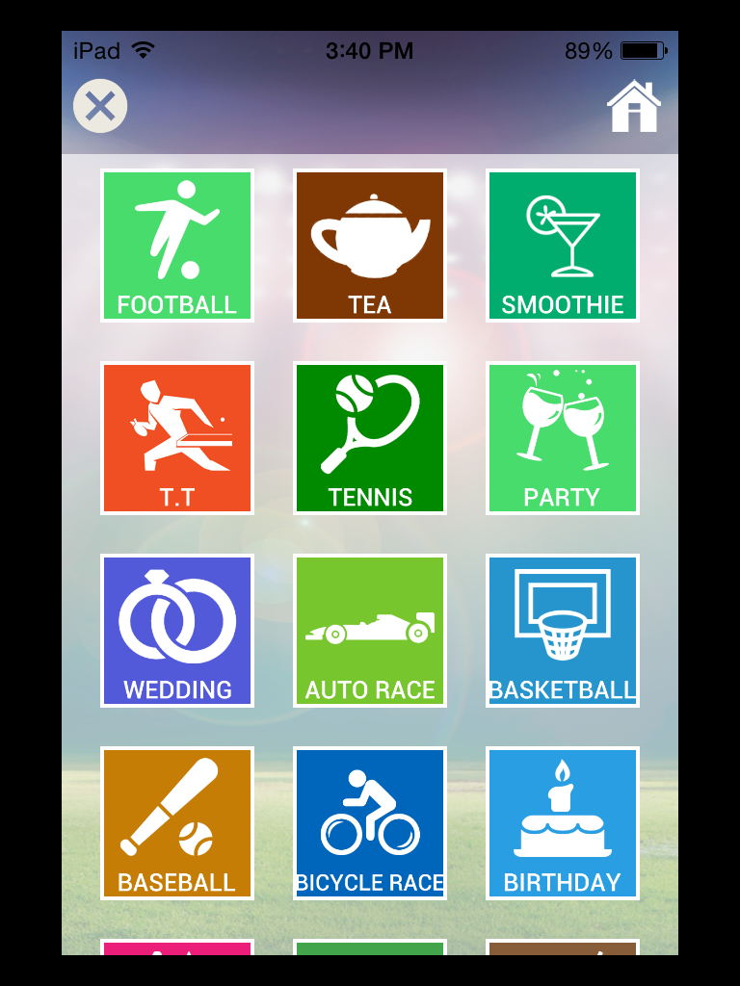
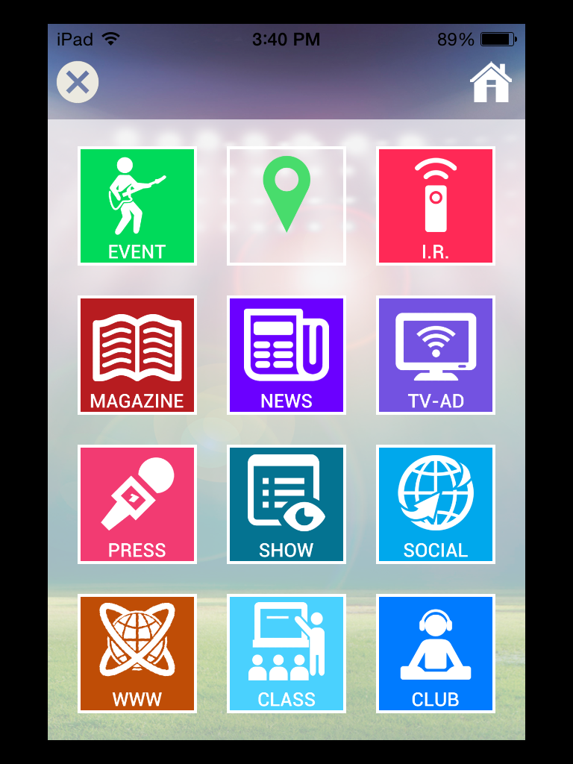
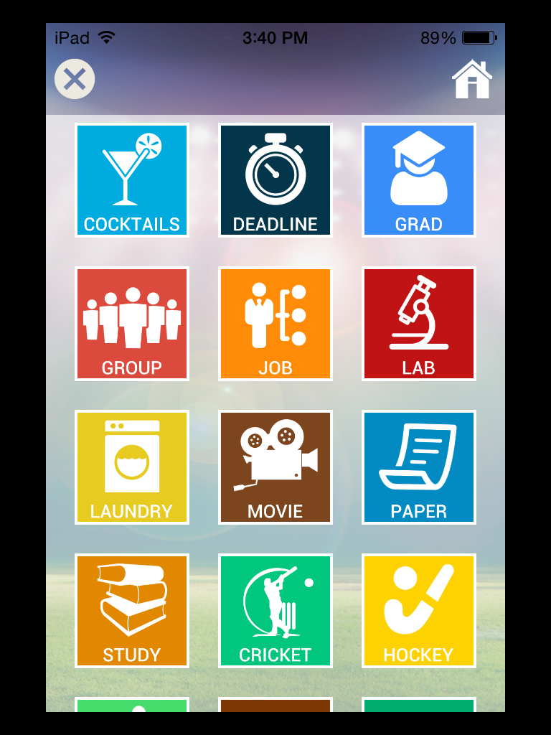
1 - Tracking - KTO-keep track of it all
Acticons™ action-icons is a trademark of TECHtionary Corporation - all rights reserved
© TECHtionary.com

Slide 19
1 - Tracking - KTO-keep track of it all
Political event impacts – war, tariffs, Brexit, etc.
Governmental – rules and regulations, compliance, etc.
Technology leveling – technology drives competition
Random – global warming
© TECHtionary.com

Slide 20
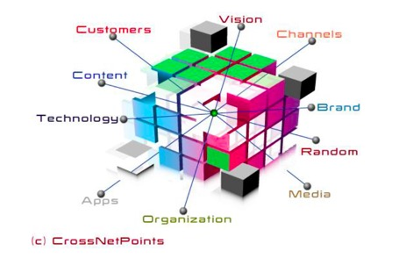
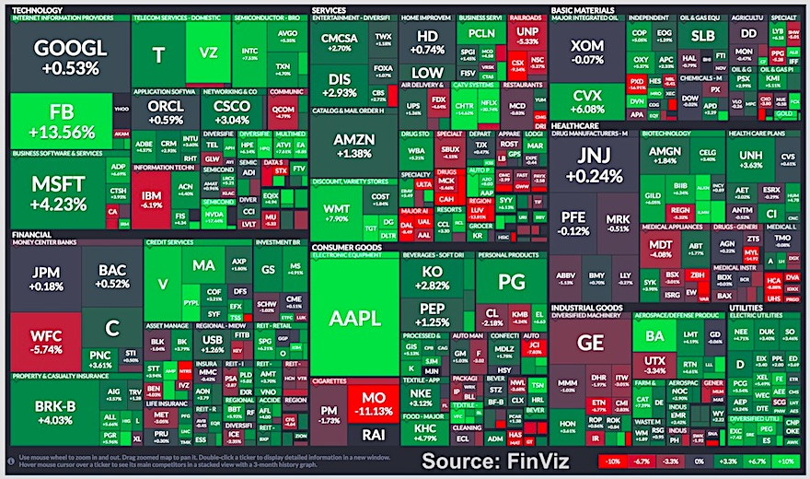
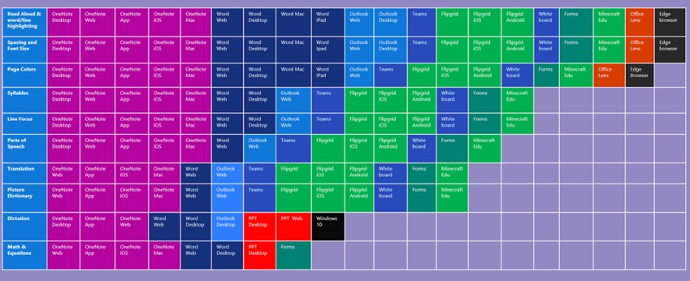
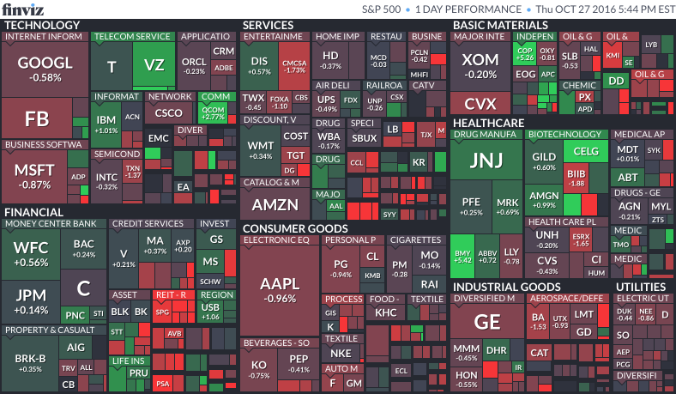
1 - Tracking - KTO-keep track of it all
Build a heat or spaghetti weather map for competitors, startups, industry trends, global issues, even the weather, anything that could impact your biz.
https://flourish.studio/examples/
© TECHtionary.com

Slide 21
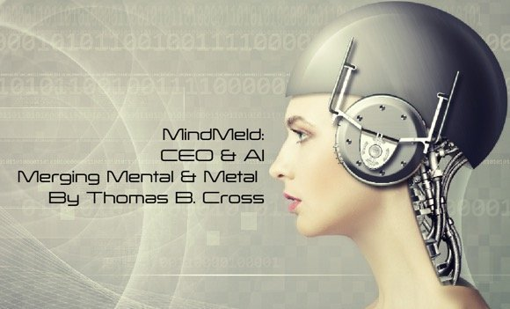
2 - Technology - Faster than ever including AI, quantum computing and more
Auto-pilot is not AI
Saying you have AI is not AI, just more fake tech as AI is not just an algorithm.
You will be assimilated, resistance is futile ~
Every job can be automated a little or a lot.
Japan spending $1 billion on robots targeting anyone over 21
History of Algorithms
https://bit.ly/2TkOQay
© TECHtionary.com

Slide 22
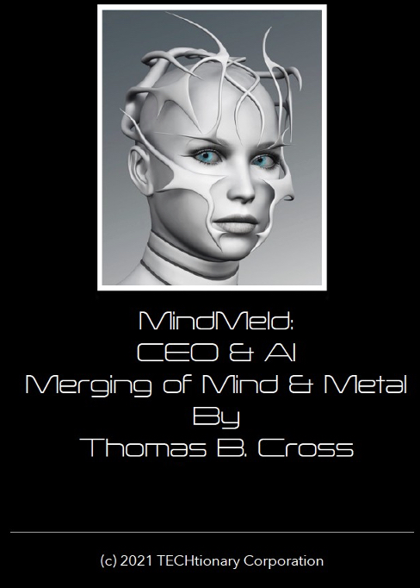
2 - Technology - Faster than ever including AI, quantum computing and more
Build a quantum-driven Ultra AI system merging mental “humint” and “machine-int” metal encompassing all business elements and divisions.
© TECHtionary.com

Slide 23
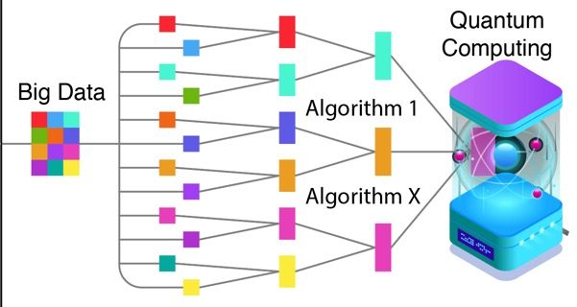
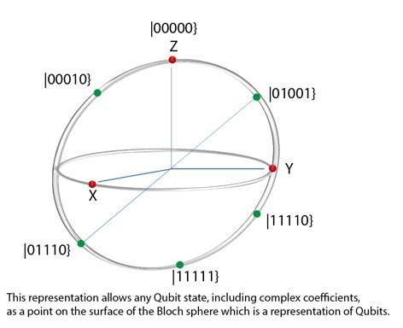
2 - Technology - Faster than ever including AI, quantum computing and more
In 100 words - Quantum Computing is a:
Quantum change in hardware design with no binary (1/0) transistors but multi-dimensional quantum system a single Qubit consists of two levels, labeled |0⟩|0⟩and |1⟩|1⟩ or 1/0/both with three Qubits or 2³ 111, 001, 000, etc with 50 Qubit having 50 decimals, and so on
Quantum leap in processing power with scalable process with current levels of 100 Qubits leading to an infinite number of states in the future
Quantum different approach to building artificial intelligence in the form of special algorithms known as quantum information with sci-fi quantum teleportation envisioned.
© TECHtionary.com

Slide 24
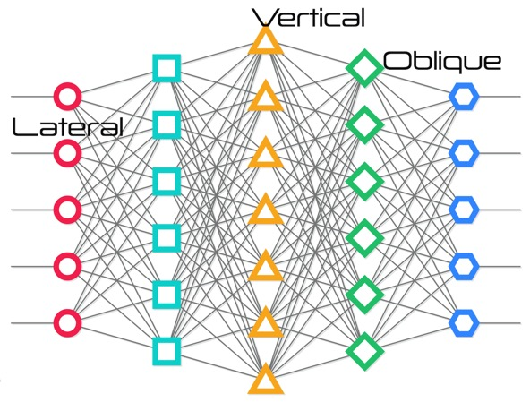
Vertical Intelligence is in simple terms making not one kind of soup but all kinds of soup. Creating different kinds of soup is actually much harder than you think. This is most of what machine learning is today.
© TECHtionary.com

Slide 25
Lateral Intelligence is where one set of skills can be applied to other thinks. This is where AI gets complicated really fast.
As humans we can get off our bikes and drive a car without even thinking about it. However, the skills for each are completely different from a machine perspective.
© TECHtionary.com

Slide 26
Oblique Intelligence is different. Oblique is somewhat in between vertical and lateral. It combines concepts used by both but brings new solutions. This makes this type of intelligence "oblique" in the way it will emerge. Telling a joke, music, touch, evoking emotion, inspiring leadership are forms that humans don't really understand all that well but provide real humanity.
© TECHtionary.com

Slide 27
Each form whether vertical, lateral or oblique offers unique challenges to the developer, user and benefits to society. Build crosspoints or intersections to meet specific goals.
© TECHtionary.com

Slide 28
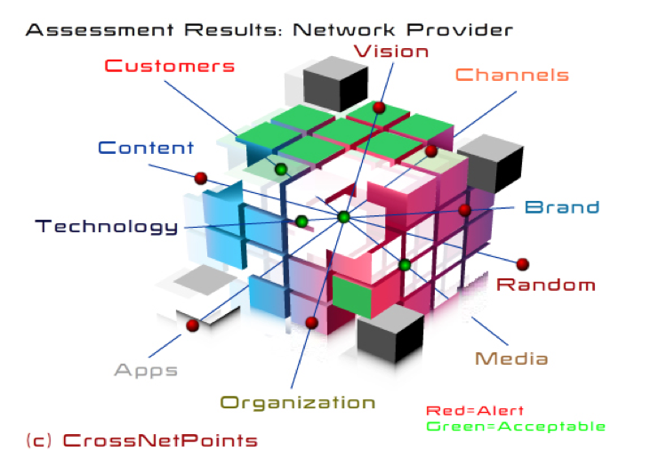
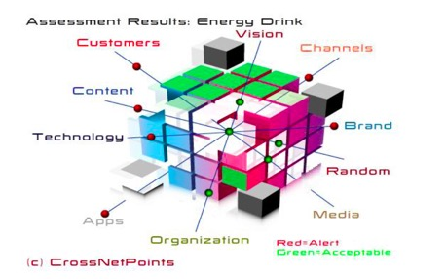
© TECHtionary.com

Slide 29
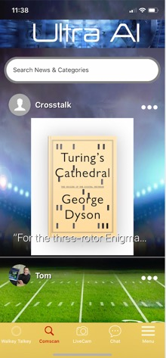
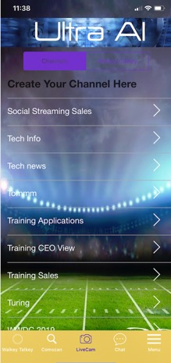
This is customized company-specific Ultra AI designed to Guide ALL staff and others in their content development and delivery.
© TECHtionary.com

Slide 30
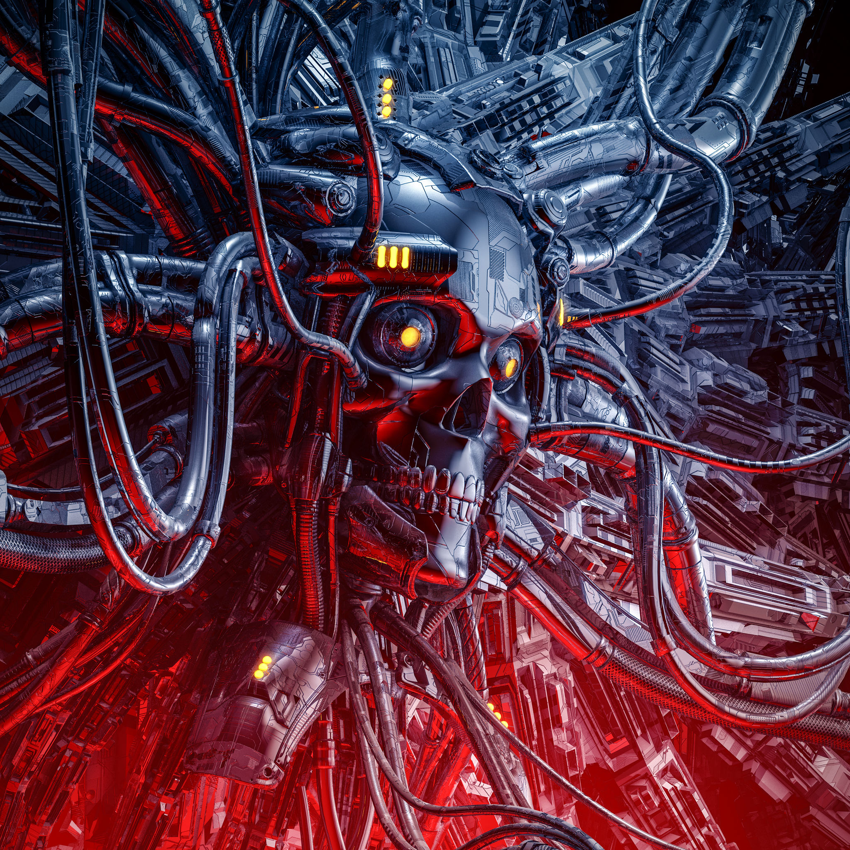
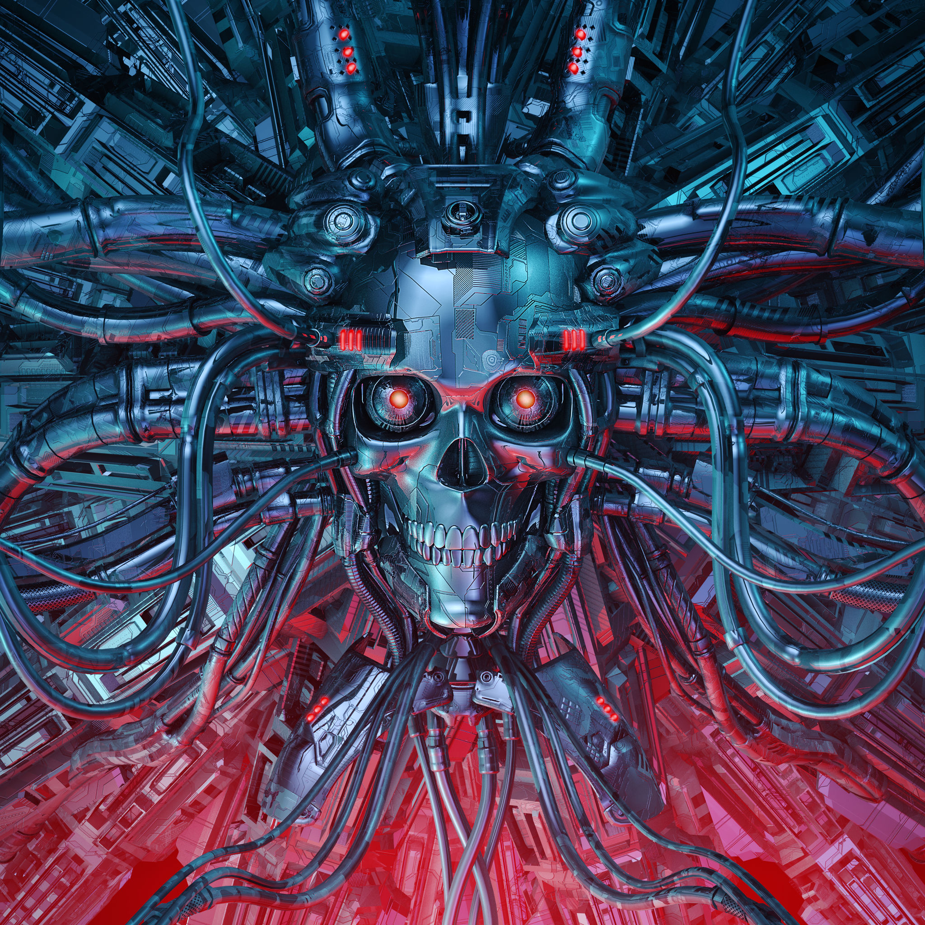
2 - TECHNOLOGY – YOU cannot predict or react to AI Failures
Here are some of the key AI failures not including really malicious efforts:
Too narrow - one SKU not others
Too wide - breadth not depth - can analyze ocean water but not what's in the ocean
Too complex - helps with auto but not truck claims
Costs too much - analyzing data takes a lot of time and computing
Changing needs - AI systems work best with solving a large problem that don't change
Sequential failures -. An example might include "after I go down Pearl Street, what happens when it stops at the Pearl mall?"
Escalation failures - the AI system may not provide call routing to the right agent even after a long series of questions
Cascading failures - too much interdependence on other systems aka APIs for solutions.
Contraindication - one of the greatest threats to healthcare is all the "side effects" facing patients compounded with all the other "side effects" from taking often two or more other medications. The challenge is that each human is different, and medications can impact each one differently.
Adversarial inputs – thinking the data is one thing when it is something different.
Data poisoning – someone “roffied” or spikes your algorithm to yield the wrong results or conclusions.
Future - AI is machine programmed for now and while models can be built as seen in weather forecasting, they are often wrong and not capable without humans to change as the climate, business and other needs do, nor address calamities and other crises.
Larry
Moe
© TECHtionary.com

Slide 31
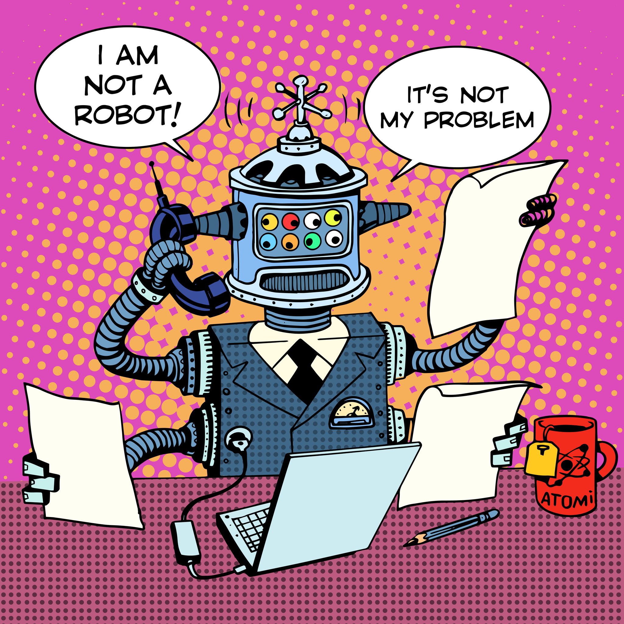
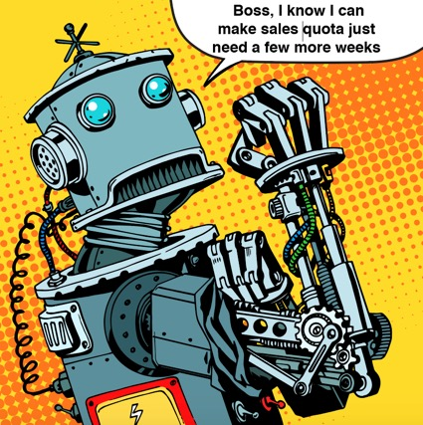
AI Humor
Toxic Workplace Takes
on a New Meaning with
Robot Boss Rage
https://bit.ly/2yK5bMw
© TECHtionary.com
Bee-Lolita

Slide 32
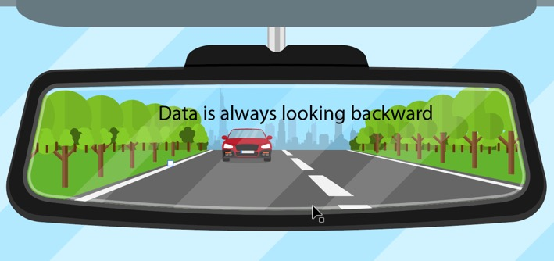
3 - Tasks – Ahead, Behind and looking in the Sand
Now that you have some ”things” to track and technology to do that, what are the tasks ahead: clue, its not looking backward.
One CEO noted, “marketing is in danger of degenerating into a graveyard for statistics because it is inclined to regard intelligence as an end in itself . .”
© TECHtionary.com

Slide 33
3 - Tasks – Ahead, Behind and everywhere else
Delete all social media accounts and build your own social network(s) for both internal and external communications to stop the toxic nonsense, mis/disinformation (anti-vaxers), weaponized media, cyberbullies, shamers, haters, privacy violations, counterfeiting fake and deep fake attacks. The reason is simple you cannot predict, you cannot react to these attacks, you can only direct your own messaging. That is, the only way to control your destiny is by building it yourself not using any other platform. If you prefer, no better weapon to have than your own.
Note on Influencers – make sure they follow the FTC and
country-specific rules/laws
© TECHtionary.com

Slide 34
4 - Terrorism
Any kind of crisis will “kill the bottom-line.” Our research has also found an increasing number of customers spend a lot of time in before, during and after purchase in due diligence avoiding the RGE factor looking for thought leadership, crisis’s and content useful in their purchasing as well as customer complaints regarding solutions.
In other words, create and deliver
“thumb-stopping” content.
© TECHtionary.com

Slide 35
4 - Terrorism
Are you ready to fly on a 737Max?
View of passengers and Boeing parts suppliers
© TECHtionary.com

Slide 36
4 – Terrorism - external
For purposes of this presentation:
Terrorism are events perpetrated by others against you.
Trust are events or efforts of goodwill, negligence or incompetency by you.
Your Ultra AI should encompass this.
© TECHtionary.com

Slide 37
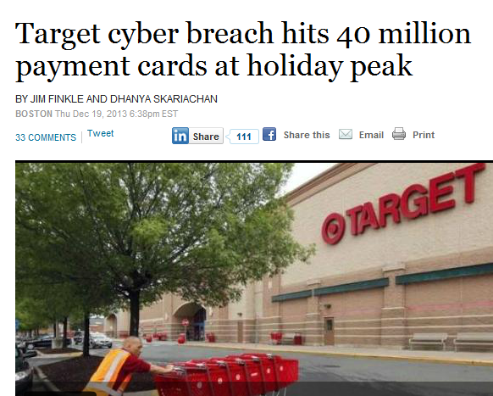
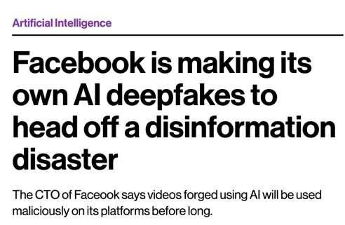
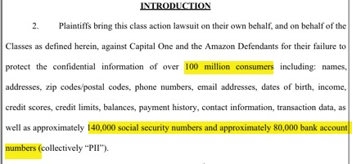
4 - Terrorism
In Ultra incorporate a emergency management system aka crisis response reputation management team to address situations such as Boeing 737Max (internal), Target (terrorism and internal), Wells Fargo (both), BP (internal), Chipotle (unknown) and other corporate devastating consequences with 7x24 realtime “live” updates and demonstrating customer concern.
It is only a matter of time before this happens again.
© TECHtionary.com

Slide 38
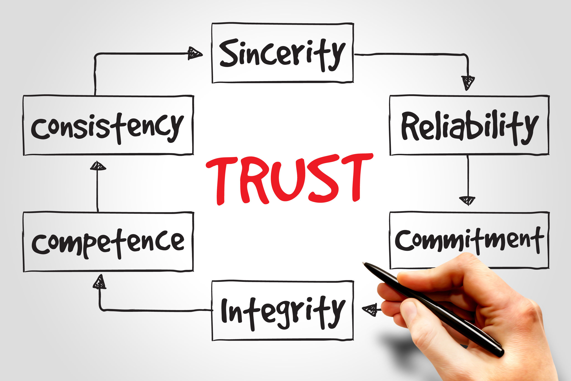
4 – Trust - internal
© TECHtionary.com

Slide 39
4 - TRust
There are four players in Trust Management:
Authors
Actualizers
Auditors
Analyzers
Trust
Rust
Just one example of one that worked for a fintech company
© TECHtionary.com

Slide 40
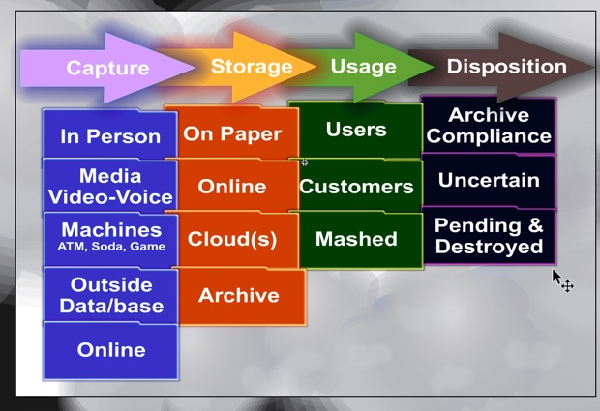
4 - TRust
Authors are the senior/executive management and legal leaders providing strategic direction in the form of all-encompassing ideology.
Actualizers was the best term we could find that covered anyone and everyone who touched data, applications, content, database, systems, managers, archivists and anyone else.
© TECHtionary.com

Slide 41
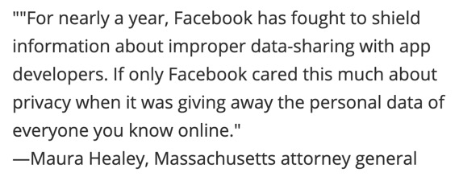
4 - TRust
Auditors may have the simplest role of checking on how actualizers followed authors’ policies.
Analyzer reviews and checks the auditors (aka audit the auditor) to determine if the auditors are practicing their processes and documentation uniformly and universally across the enterprise. In addition, given increasingly compliance and regulatory oversight the Analyzers provide an additional independent layer of review and analysis. This additional layer of review is that the balancing security and privacy is getting more, not less complex.
© TECHtionary.com

Slide 42
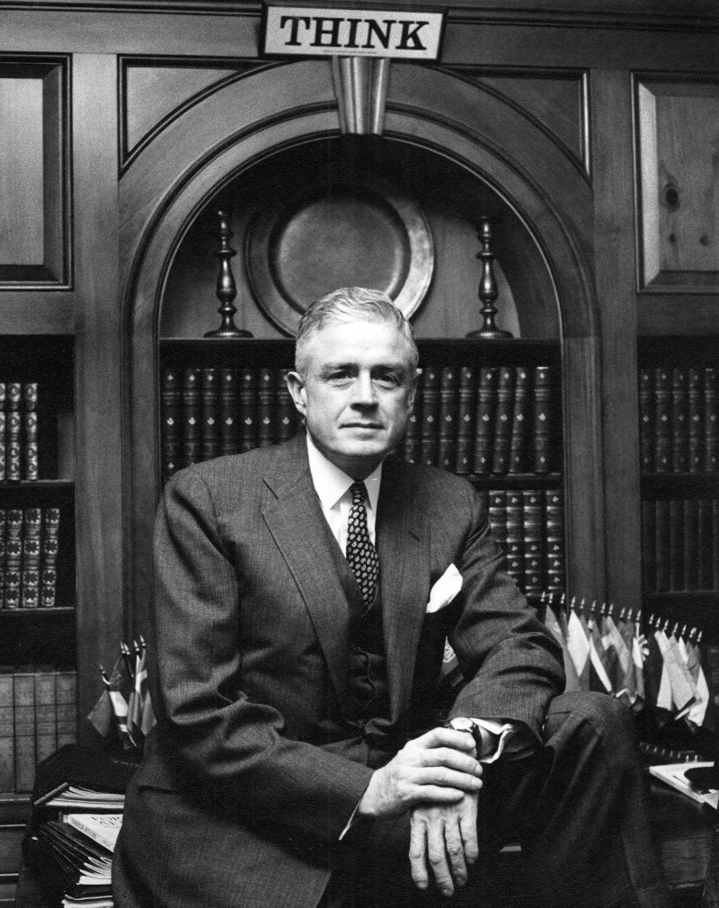
5 – TEAM – CEO As CRO – Chief Reputation Officer
The new social CEO - reports of CEOs spending more than 50% of their time articulating and defending themselves and the company on public policy issues. They thought they had lobbyists but they are the chief lobbyist.
Source Fortune
Courtesy: IBM - Thomas J. Watson, Jr.
© TECHtionary.com

Slide 43
5 – TEAM – FOCUS ON REPUTATION
Key areas where building your own internal Ultra social network is key to industry, market and company leadership as it:
Improves Thought Leadership
Guides Influencer Marketing
Accelerates channel engagement
Improves sales lead generation
Mitigates social media crises
Works on solving toxic culture issues
© TECHtionary.com

Slide 44
6 - Trends - Direct, not predict or react
Not where are customers now and but where are they going and how fast can you “walk in their moccasins” now and in the future – will you meet them at the bottom?
Expect 4x4
© TECHtionary.com

Slide 45
FUTURE INTELLIGENCE Industry
6 - Trends – Direct YOUR OWN FUTURE ROADMAP
Content
Cloud Streaming
AI
Bio
styles
Services
Games
Devices P2M to M2M
Formats
Products
Machines including Quantum
Conduit
Content
Fashion
© TECHtionary.com

Slide 46
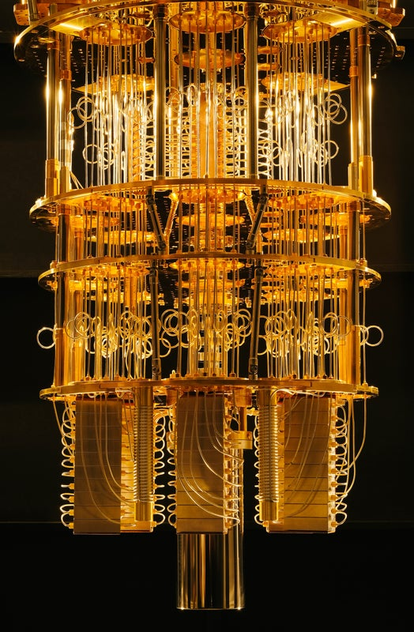
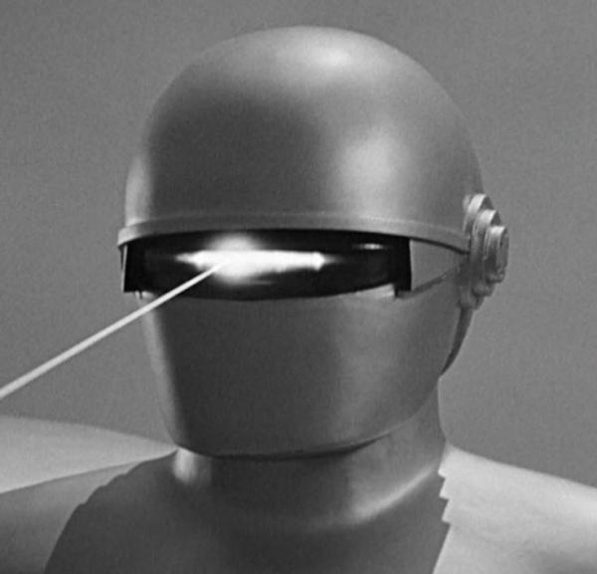
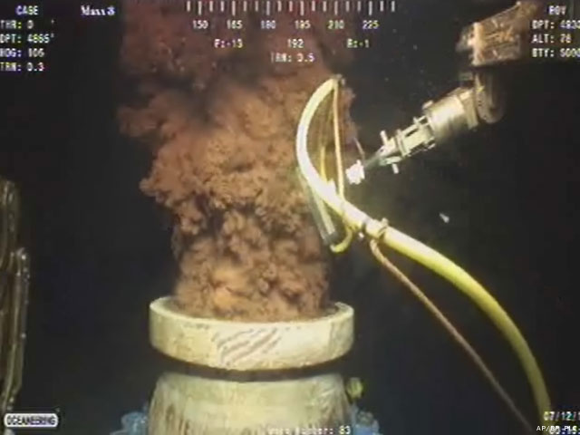
6 - Trends – 2025 Too Short & Too FAR
+ Real AI Not Really
Rising deaths by weaponized robots
+ Quantum Accessible to All
+ Privacy Paramount
Yet not ever possible
+ Technology Implosions
Global auto/health tech attacks
+ Global Change Extinctions
FLU-EBOLA global events
IBM 50 Qubit

Slide 47
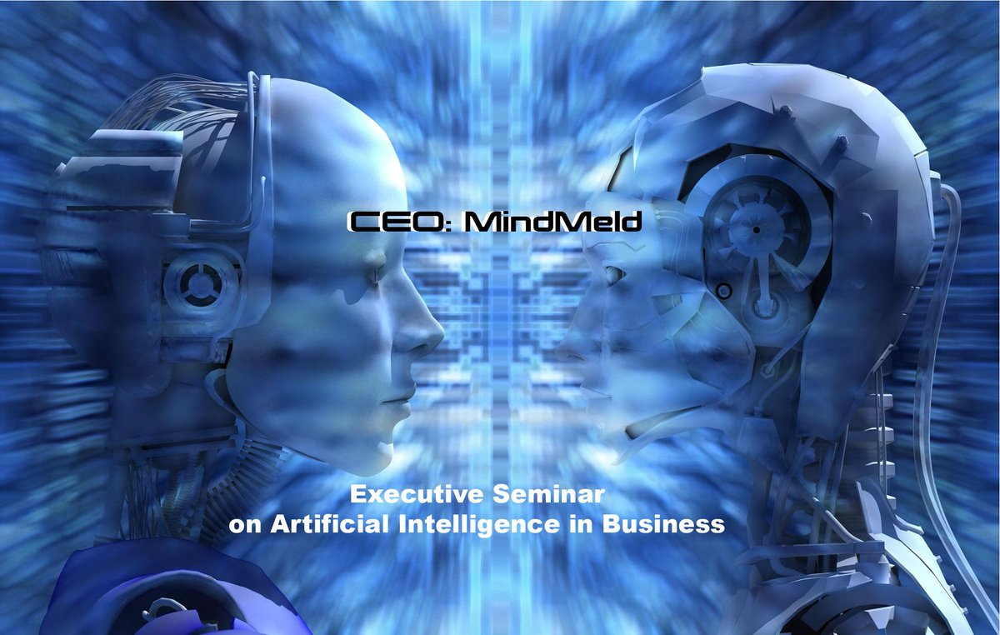
CONCLUSIONS
Ultra Concepts work – examples of results:
Ultra corporate intelligence platform
Economic and Business Development Forecasting Center
Educational Center for Excellence
Cloud Marketing Development
National Channel Partner Program
Corporate Customer Program
Global AI Research Center
Others I can’t talk about
© TECHtionary.com

Slide 48
NEXT STEPS – no one kind of assessment, each one is unique:
Begin Ultra Crisis Intelligence system – it’s an art, not a science as design, development and delivery takes time and is a “repeat cycle”
Develop Ultra crisis analytics including internal and competitors
Evaluate results like legal discovery you may have a premise but the outcomes may lead in many directions
Iterate until you find viable solutions
Report findings
Develop and deliver
Repeat
© TECHtionary.com

Slide 49
References
“Tom Cross is seriously one of the great thought leaders of our era. Having written more than 1,000 articles on the widest range of technology, applications and business leadership, he has helped 100s of companies accelerate their performance and succeed in their pursuits. He is a superb strategist and thinker with the ability to design and deliver on marketing, product development and channel management. I also strong recommend him for his work ethic and leadership skills."
Evan Kirstel Social Media Expert
© TECHtionary.com

Slide 50
References
“Becoming a global social media influencer and thought leader in the technology industry demands a rare mix of communication and marketing expertise combined with broad and deep technical experience. Tom is a thought leader in both B2B IT and B2C application solutions. He has content development and delivery skills across a wide range of technologies including AI, social media, social selling, mobile apps, IoT, IoMT, network security, blockchain, machine learning and quantum computing. He has a unique ability to translate complicated technologies and opportunities into actionable insights for business leaders from the C-level to the floor-level. If you need help generating and communicating compelling stories about your technology products and services, I recommend you contact Tom. He will challenge you to think differently and act differently in how you communicate the value of your solutions to customers, partners and markets.”
Roger Toennis – Senior Director Gartner Retired
© TECHtionary.com

Slide 51
Other Seminars

Slide 52
Enterprise Sales Acceleration – B2B Professional Development Program
Proven sales revenue acceleration across thousands of B2B sales professionals that:
Reduces sales cycle
Increases competitive edge
Reduces staff turmoil and turnover
Produces higher margins
Provides improved sales leadership
Is designed for Small, Medium, Major, Channel and Enterprise Markets
Addresses UC, Collaboration, IT, VAR, MSP, Cloud, Security, IoT, other providers and channel partners
Developed and Delivered by TECHtionary.com
To Schedule email cross@gocross.com or call 303-594-1694
© TECHtionary.com

Slide 53
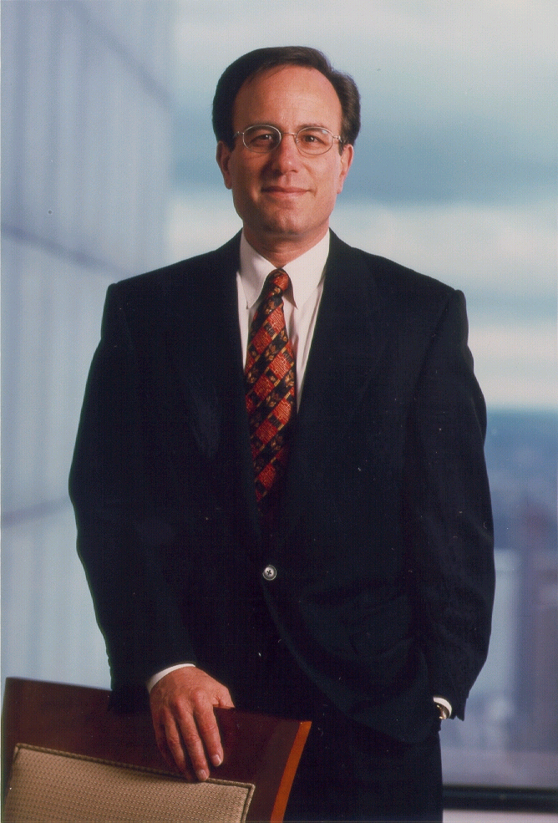
Enterprise sales acceleration goals
Presents enterprise solutions selling scenarios.
Understand what customers especially enterprise business customers are looking for and expect from a provider of integrated applications solutions and networking services.
Understand what are the situations, success factors and solutions in making the sale and how you can make a difference in your prospective and ongoing customer relations.
And, most importantly, maximize the confidence-to-close factor and the customer gain-retain ratio.
“Confidence is a demonstration of knowledge.”
Ivan G. Seidenberg
Former CEO Verizon
© TECHtionary.com
Notes:
As you may have seen by now, our vision statement is “building confidence through knowledge.” It reflects our view that the ultimate goal is to provide tools that give students knowledge to give them confidence in their ability to provide solutions for their customers.
Present solutions selling scenarios.
Understand what customers especially small-to-medium size business customers are looking for and expect from a provider of integrated data and networking services.
Understand what are the situations, success factors and solutions in making the sale and how you can make a difference in your prospective and ongoing customer relations.
And, most importantly, maximize the confidence-to-close factor and the customer gain-retain ratio!!!

Slide 54
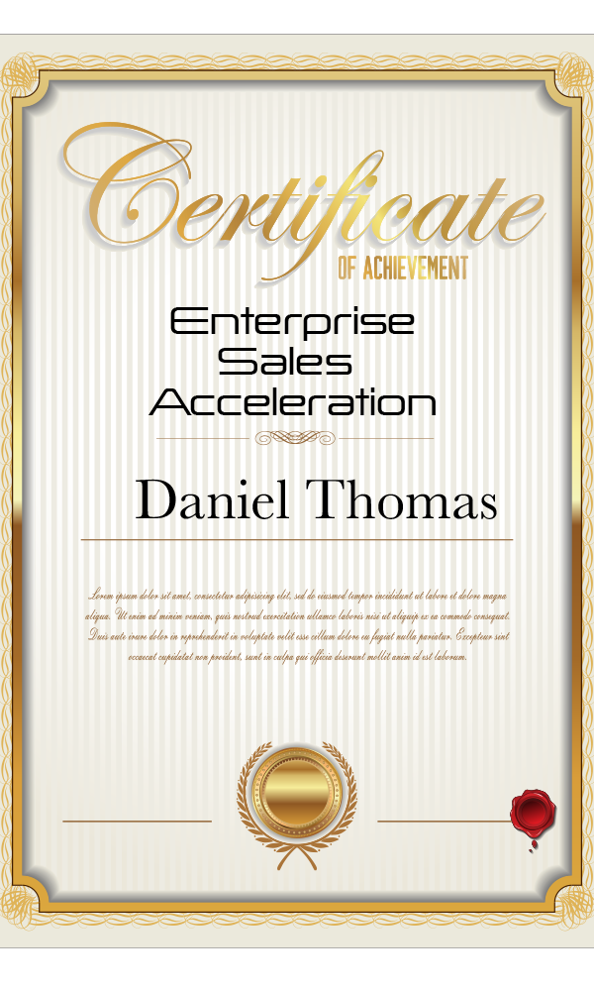
Comprehensive Professional Development
This course is part of a comprehensive curriculum in career and leadership development program.
© TECHtionary.com

Slide 55
About Tom
© - @evankirstel & TECHtionary.com

Slide 56
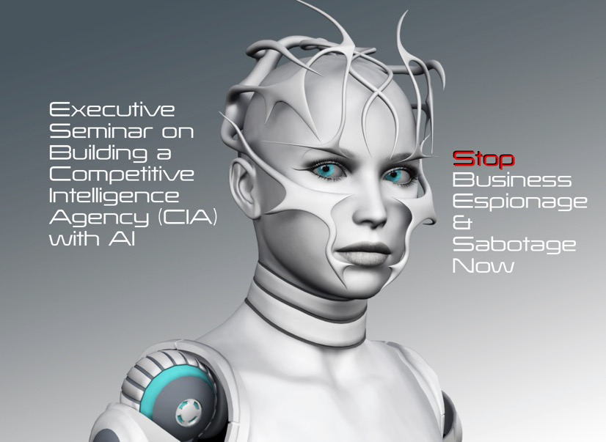
About Tom
Strategic Customer Business/Product Assessment and Executive Workshops
email cross@gocross.com
© - @evankirstel & TECHtionary.com

Slide 57
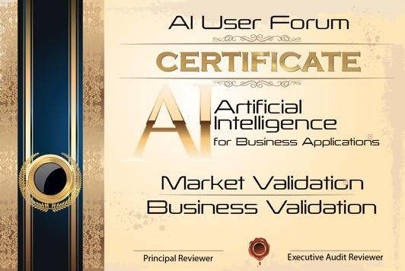
Strategic Customer Business/Product Assessment and Executive Workshops
+ Ultra AI System
email cross@gocross.com
© TECHtionary.com

Slide 58
THANK YOU
FOR ATTENDING
THANK YOU
FOR ATTENDING
© TECHtionary.com

