Slide 1
What is this ? Get Your Own “NetFlix” Live and OnDemand Video Network and..
To produce your own movies, video, etc. to BYOD-Build Your Own Branded Network
This is a multi-channel live and ondemand video network, news feed, video meetings, webinars, virtual event(s) with multi-party chat and content media management library built on your own domain name to produce multi-channel video for both live and ondemand content, travel-tourism, virtual meetings, podcasts, sermons, sales leads groups, webinars, masterclass, news channels and social media platform.
1-2023 v.35
© SocialStreamingTV.com

Slide 2
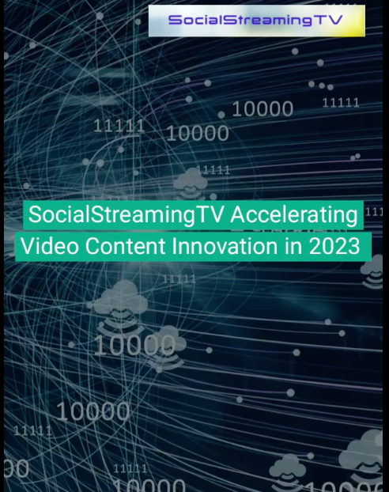
FAST PITCH PRESENTATION
Click on image to the right for 2-minute video on 2023 strategy
Contact:
Tom Cross
cross@gocross.com
303-594-1694
© SocialStreamingTV.com

Slide 3
“What is the Problem and What is the solution.”
Problem for All Website “Spaces” - “If your competitors give viewers a better reason to visit their website, they will go there and even again. And, they may never ever back to your website.”
Solution – For any solution ”spaces” build live and ondemand video and content network with virtual demonstration events and more to show viewers what it will be like when the do come and all the fun things they have as well.
Let’s see what the solution can look like !
© SocialStreamingTV.com

Slide 4
There is one example for virtual video streaming “spaces.”
Viking.TV is a travel tourism video network with live and ondemand videos.
© SocialStreamingTV.com

Slide 5
Problem-Solution for Travel-Tourism
Problem for Travel Places and “Spaces” - “If your competitors give tourists a better reason to visit their resort, park, hotel, amusement, museum, or flight to outer space they will go there and even again. And, they may never ever come to your space.”
Solution – For travel ”spaces” SocialStreamingTV can build live and ondemand networks with virtual demonstration events and more to show visitors what it will be like when the do come and all the fun things they have as well.
Let’s see what the solution can look like !
© SocialStreamingTV.com

Slide 6
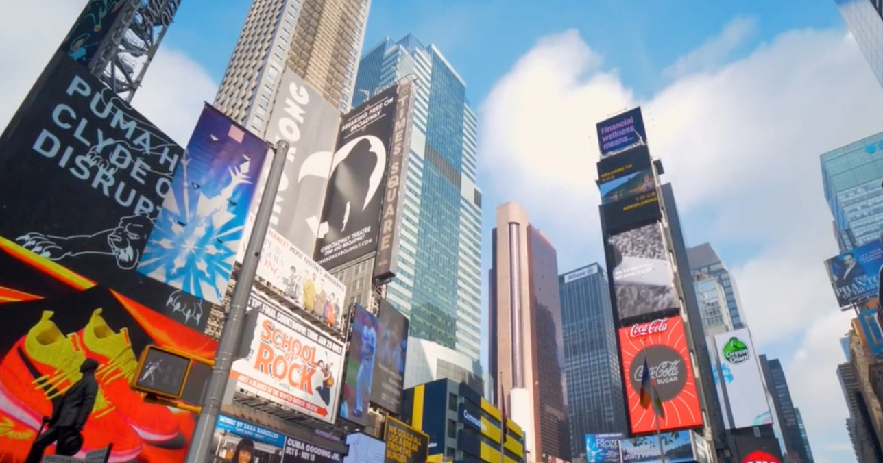
Solving One of the Toughest Personal and Families Challenges:
Where To Go on Vacation?
Billionaires Faceoff – Branson v. Bezos
So Many Places To Go Urban Space, Outdoor Space and Now Outer Space Tourism !
To Compete Every “Space” Will Have To Promote Themselves Even More
© SocialStreamingTV.com

Slide 7
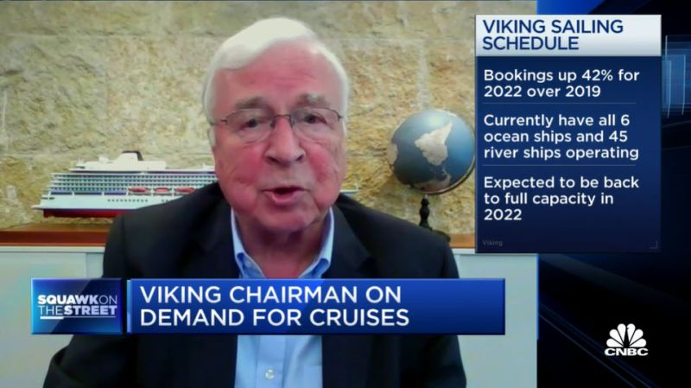
The results are dramatic with bookings up 42% !
We didn’t build Viking.TV – we can build a better network to provide resorts, fun places, travel providers and others with their own private branded video network.
© SocialStreamingTV.com

Slide 8
Strategic Benefit - With live and ondemand videos every resort, destination, travel and destination provider can show visitors what they can do before they go and travel such as amazing castle tours, fabulous restaurants, exciting shopping, and engaging events which stimulates the imagination and "wets the appetite" for the traveler to go travel live sooner and return more often.
© SocialStreamingTV.com

Slide 9
SocialStreamingTV.com Solution - Building Live and Ondemand Video Networks Product Features:
Stream up to 55 live video channels simultaneous anytime from almost anywhere to build your own business NetFlix network with both live and ondemand video add more URLs for essentially unlimited live channels for potentially millions of viewers
Viewable without having to login or download an app but users can register to chat/post
© SocialStreamingTV.com

Slide 10
SocialStreamingTV.com Product Features:
SSTV provides Get Together™ featureset for video meetings many call it better than Zoom™ and Clubhouse™ group audio podcasts with recording and transcription features, chat and many more with nothing to download or login
Key customer benefit – private branded custom website as a SaaS-software as a solution cloud managed solution provider (MSP) model
Customized user interface –Unlimited content newsfeed with text, audio, video content by unlimited topics
© SocialStreamingTV.com

Slide 11
SSTV Direct Customer And Channel Partner – MSP Channel Sales
“SocialStreamingTV.com is a trusted provider and proven in the LiveStreaming and Virtual Events category.”
Dan Baldwin Telecom Association’s Executive Director
© SocialStreamingTV.com

Slide 12
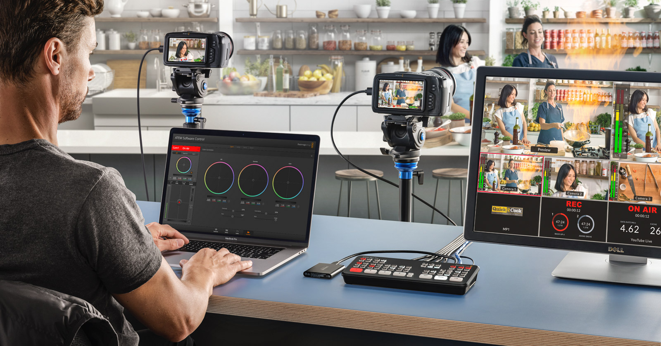
SocialStreamingTV.com give us a seriously great delivery system and a multi-channel method to deliver classes and events in a targeted way, with a new level of user engagement."
© SocialStreamingTV.com

Slide 13
Channel Partner – Talent Training
Help everyone be better presenters and virtual-digital sales pros with Professional Virtual Presenter skills development courses
© SocialStreamingTV.com

Slide 14
SocialStreamingTV Roadmap for 2023
Expand Meeting Event Calendar
Add Contact Center Integration
Expand Current AI features including viewer conversation “sentiment” features based on AI
© SocialStreamingTV.com

Slide 15
Indepth Features – Use Cases – Award - More
© SocialStreamingTV.com

Slide 16
Strategic View
Delivering a “Virtual-First” Events Masterclass Media News Platform
Deliver a virtual trade show & virtual sales center experiences anytime from almost anywhere
Bring the trade show booth out of storage, and put them back to work in corporate demo centers
Broadcast live and/or recorded customer demonstrations, for ondemand viewing
Direct attendees to your thought leadership, solutions and brand messaging
Ondemand archive videos can be watched and shared multiple times, with colleagues & decision makers
Longer lasting and more impactful than a one-time one-venue events
It’s your private TV 7x24 station, so you control content and advertising (e.g. banner ads)
New niche company, speaker, concert, tours and events previously uneconomically are now feasible
© SocialStreamingTV.com

Slide 17
Tactical View
Most events of any kind are virtual now and if they come back at all will be hybrid – virtual and live even when health conditions permit widespread in-person elements again
The world is ”flatter” than ever as virtual events can go anywhere
Virtual events are not limited to one-time or a few times a year but can be anytime
Virtual events are not one-show at a time but tens or hundreds of simultaneous events
Current virtual events platforms are really expensive on the order of tens of thousands per one-time event with user-interfaces that have been called “goofy” and ”childish”
Control of social media and newsfeed is needed to bring corporate branding governance back
Time to build your own business Netflix/CNN “It’s like owning your own live TV Station, plus on-demand delivery too”
Control media distribution with out uncertain, inappropriate and unwanted ads
© SocialStreamingTV.com

Slide 18
Tactical View
Produce multi-channel video streaming, post news and promote solutions with multiple banners on SocialStreamingTV.com or get your own streaming platform on your website or new URL
Private-branded on your website/URL to protect and enhance your company’s brand and image
Absolute total administration and control of all messaging and advertising
Expandable simultaneous (simulcast) video channels for events, TED talks, music concerts, lectures, tours, travel guides, etc.
Solutions upgrades & scales when you are ready
Expand to multi-users, more channels and video storage under your control
7x24 support – we work weekends
Custom programming for special features
Low cost with zero dollar installation and low monthly fees – custom UI designs and features extra
© SocialStreamingTV.com

Slide 19
Features Overview
Private branded-label platform installed on your domain name – with video streaming, content management and social media.
55+ simultaneous video channels delivered to potentially millions of spectators and viewers with quick easy production using smartphone and switchable cameras for onsite and outside productions + viewers do not have to login to view
Share simultaneously from website to Facebook Live and customized for others
One to a few or many with many video calls with one or more people – idea for sales, support, counseling, coaching, team/group, interviews, evaluations and many other meeting types
Unlimited virtual events - webinars
© SocialStreamingTV.com

Slide 20
Features Overview - more
Without need for professional television stream from PC, Tablet or Smartphone one-touch switch to either front and back cameras
User-to-broadcaster chat
User-to-user and group chat
SMS to viewers
Buy Button for Call To Actions !
Up to two hour recording per segment – unlimited archive for replays
Share posts to Twitter and Linkedin
Future features based on proven AI-expert level experience
…many more, and still evolving
© SocialStreamingTV.com

Slide 21
Features Overview - more
Unlimited content categories and content and content management system
Customized user interface
Record on smartphone and ability to switch cameras, content for training, reports, incidents and more
"Get Together" feature for live large public group audio and video conferences.
Low cost
Professional Education Certification
Rapid installation
© SocialStreamingTV.com

Slide 22
New Features
DoorBell – World’s First Website ”Doorbell” paten—pending to start “live” video/audio or audio call with viewer
ACTicons Calendar – World’s first personal and meeting calendar with ~200 ”action icons”
Speech-To-Text – idea for capturing meetings, veterinarian, medical, compliance, lectures, sermons, etc.
Get Together Live with unlimited public meetings group audio aka Clubhouse and video/audio ”live” shoutouts
Record Video (record without having to stream)
1:X private meetings screen image enhancements unlimited members
Virtual event banners separate from Main Page banners
and so many more improvements
DoorBell and Acticon Calendar
are available in limited release
© SocialStreamingTV.com
© SocialStreamingTV.com

Slide 23
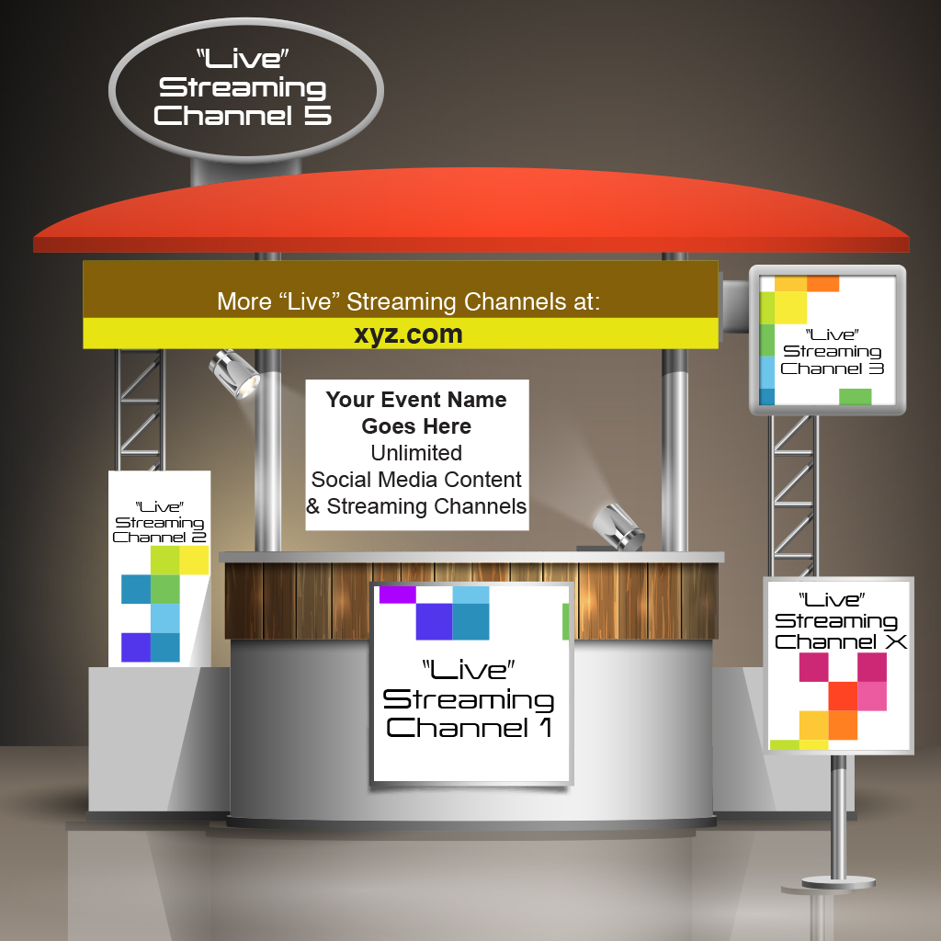
Use Case – General Business Applications
A sampling of corporate use case applications for SocialStreamingTV.com
Virtual travel, tourism, retreats and private meetings
Virtual schools, colleges and vocation education
”Ghost” restaurants and kitchens
Ondemand Sales Presentations
Corporate Conference Center Tours & Streamcasts
Corporate Education
Customer/Partner/Staff Training Events
University Conference Centers
Analyst and Investor Meetings
Virtual Shopping
Augmented Reality
© SocialStreamingTV.com

Slide 24
Use Case - Multi-channel-streams
Streaming simultaneous to 55* or more live channels or on-demand archive video channels to millions* of viewers for large classes, special audiences and lectures, tours, sports games, field trips and special education tours, etc.
Video chat for doctor-patient, vet-pet, tech support to customer, construction site to architect
Multicast streaming simultaneously to Facebook and customized for others. *Per domain name, multiple URLs for large presenter use cases. Indepth discussion prior to installation is recommended.
© SocialStreamingTV.com

Slide 25
Use Case - Smartphone Video Production
SocialStreamingTV.com leverages front and back cameras on smartphone
Switch perspective anytime
Enhances ability to focus not just on the presenter but also the problem in the field, microscope and other places where people cannot go
Video goes where you can’t go
Video goes where you don’t want to go
© SocialStreamingTV.com
© SocialStreamingTV.com

Slide 26
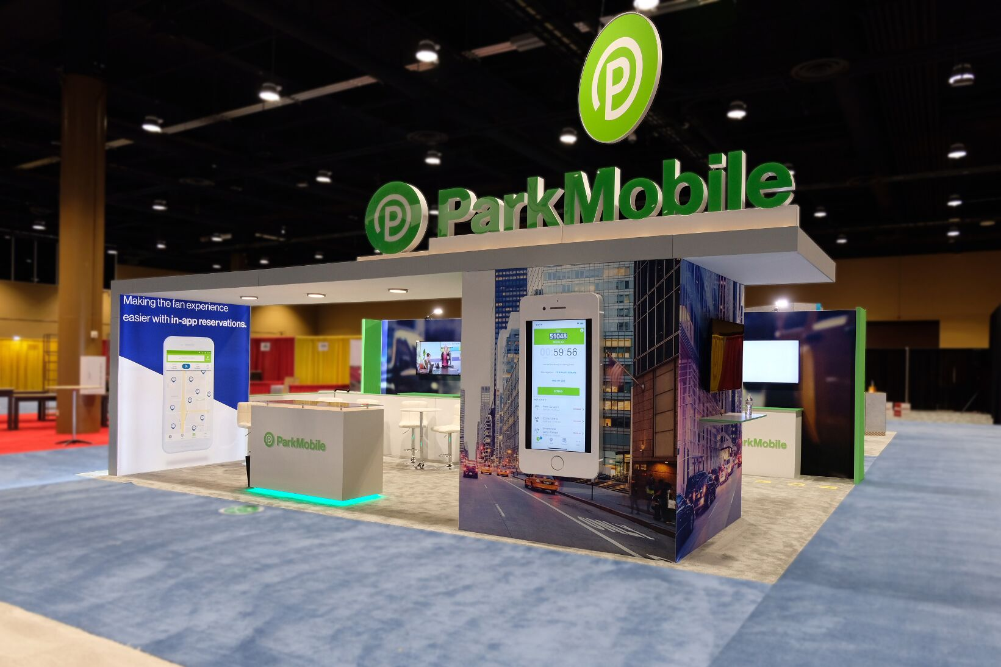
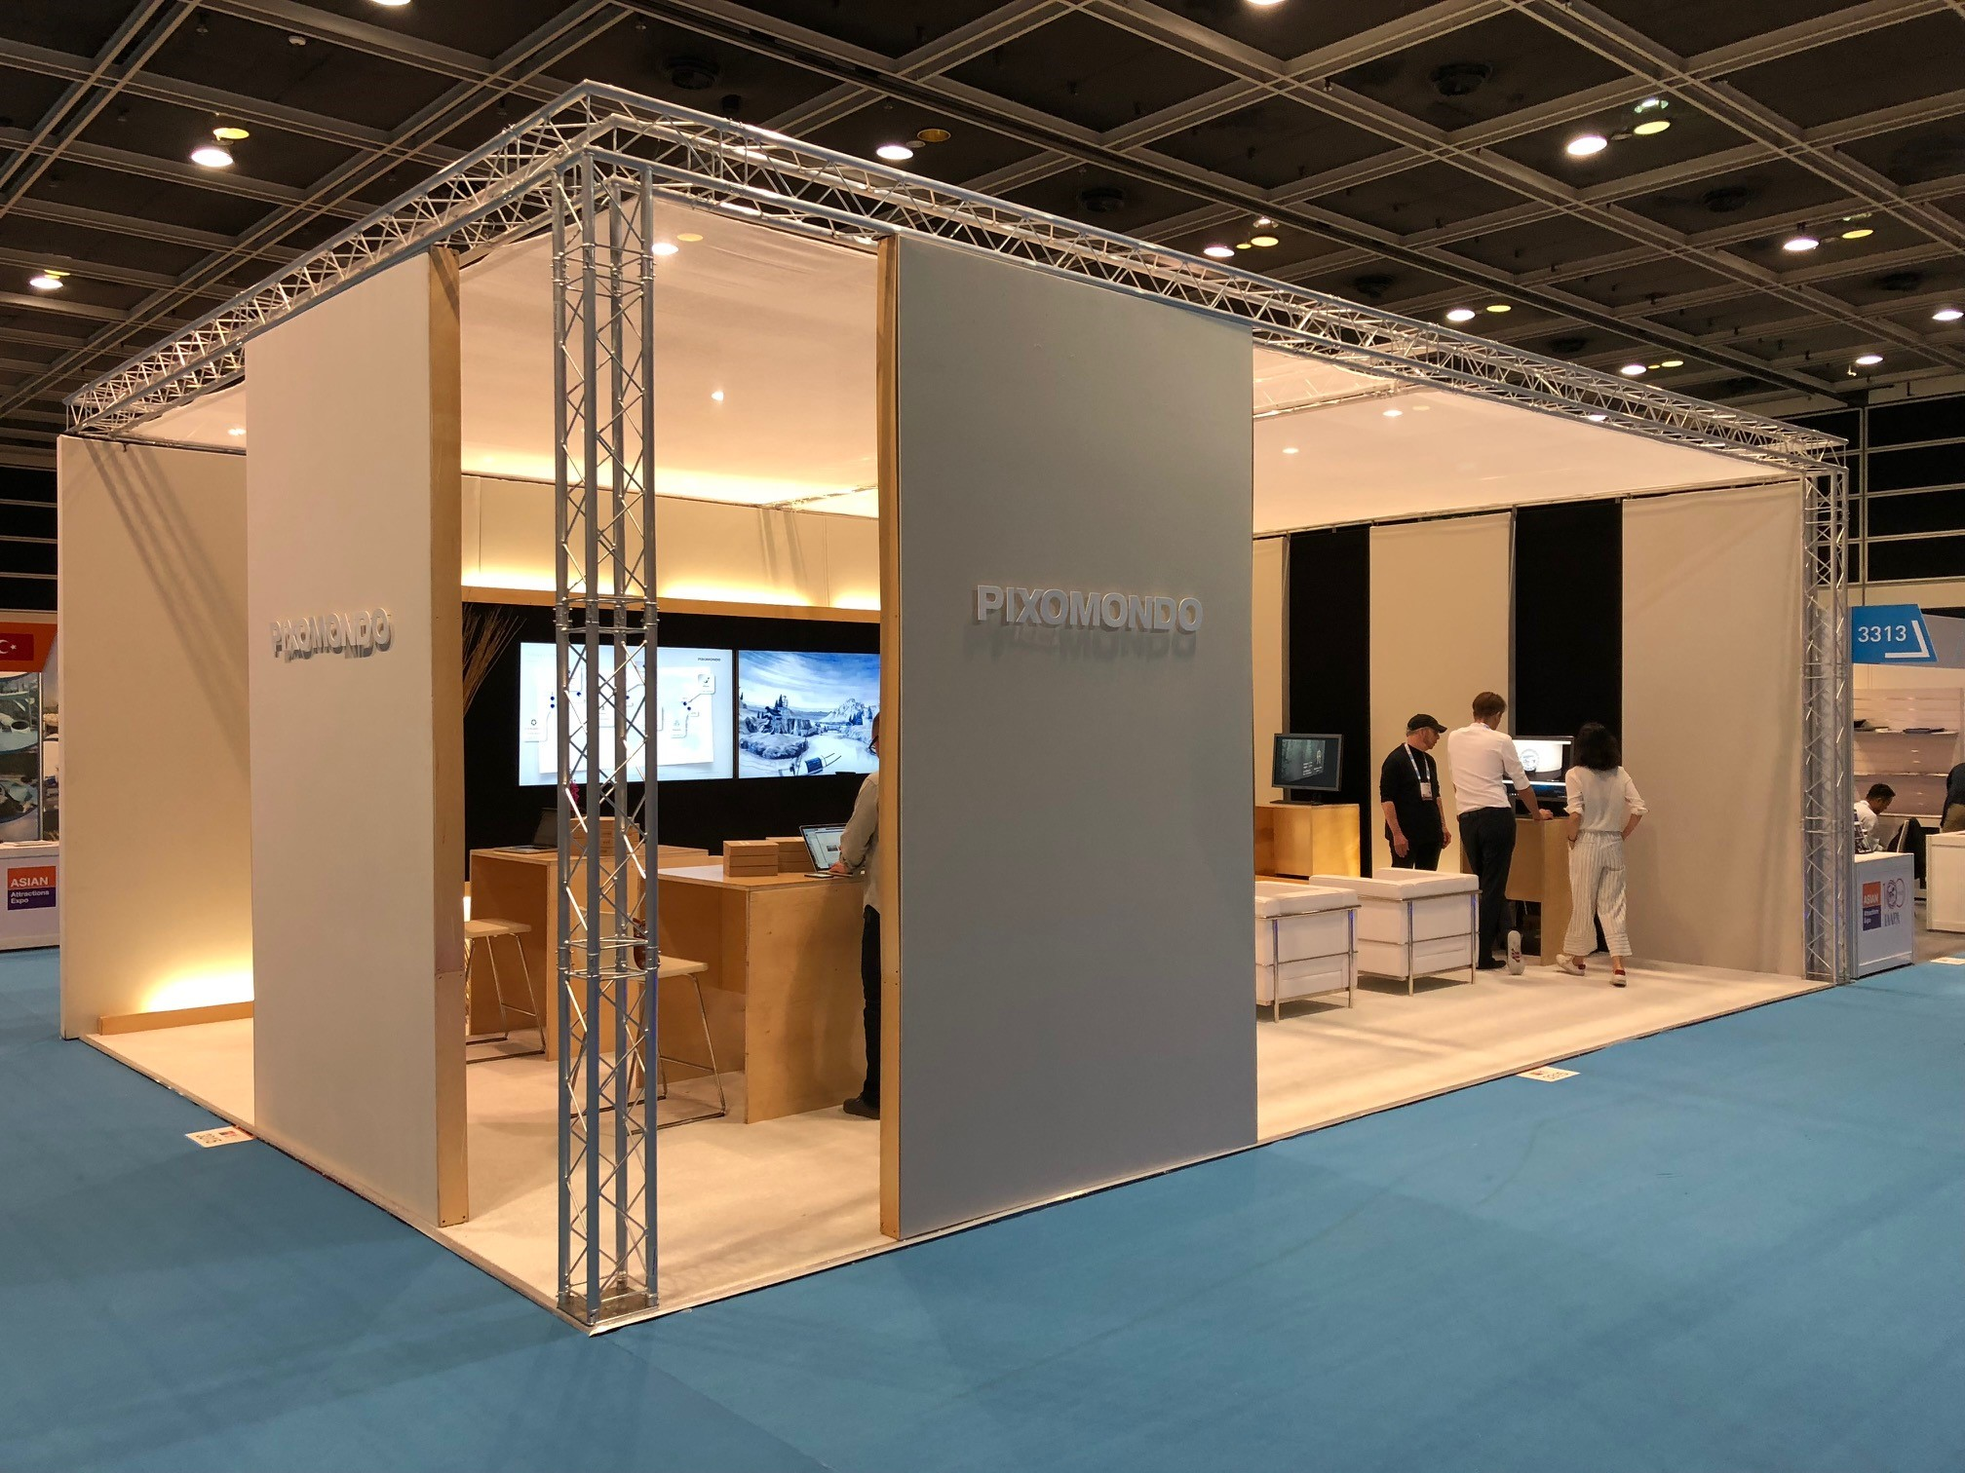
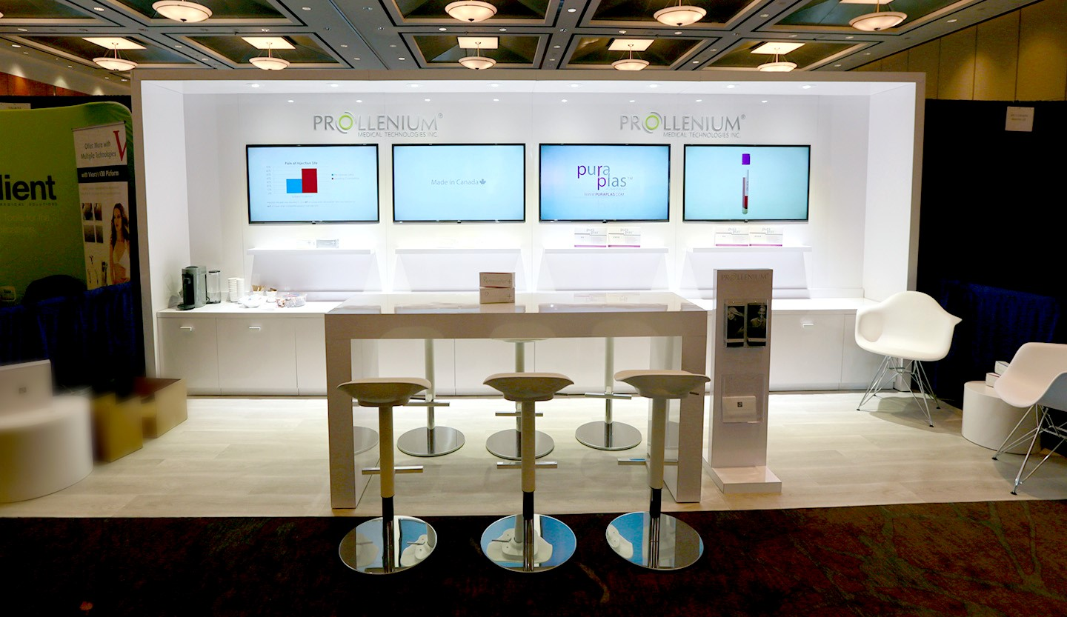
Use Case – Bring Trade Shows In House
Move your trade show booth back to HQ or Field Offices to have continuous personal trade show demonstrations - Many companies will build new and/or expand existing visitor and product demonstration centers designed especially for virtual events.
© SocialStreamingTV.com
© SocialStreamingTV.com

Slide 27
Feature Spotlight: Virtual Event Production
Social Streaming TV Virtual Events Features - Schedule unlimited virtual events with unlimited presentations, sponsors and attendees– you can be your own webex webinar and multi-day virtual event conference service to your audience. There are sponsor pages, networking pages for attendee chat and much more.
Smartphone View
© SocialStreamingTV.com

Slide 28
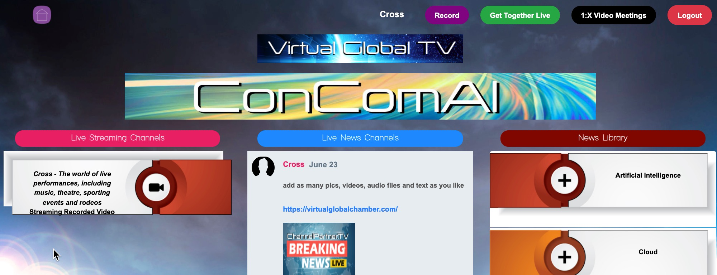
Feature Spotlight: UI
Flexible customizable user interface re-designed to fit/match company branding as needed
© SocialStreamingTV.com

Slide 29
Feature Spotlight: Rotating Banners “For Sale” to Vendors or Highlight Events, Webinars, Virtual Events, Streaming
Your Company Logo or Brand Goes Here
With product link or broadcasting streaming schedule
“We are Live Fridays or Everyday at 4PM”
© SocialStreamingTV.com

Slide 30
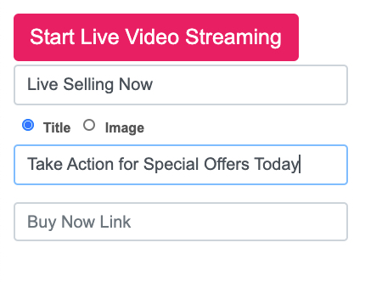
Feature Spotlight: ”Buy Now Button”
Add
Custom Message
“Buy Now Buttons”
Or Banners
with links to any page
© SocialStreamingTV.com
© SocialStreamingTV.com

Slide 31
Customer References
“Our association members are heavily experienced technology industry consultants and channel sales partners that have compared all the best and affordable vendors against one another before recommending one or two to their business clients who view them as trusted advisors”, stated Telecom Association’s Executive Director, Dan Baldwin. “They know which vendors to watch out for and which ones to recommend so having them review SocialStreamingTV.com as the “Best" means SocialStreamingTV.com is both trusted provider and proven in the LiveStreaming and Virtual Events category.”
© SocialStreamingTV.com

Slide 32
Customer References
”We offer hosted and managed Learning Management System solution to help clients organize their own content and to collaborate on developing new training programs, with anytime and anywhere delivery. We are staging the launch of a new content marketplace, built on SocialStreamingTV.com's award-winning platform, which will give us a seriously great delivery system and a multi-channel method to deliver classes and events in a targeted way, with a new level of user engagement. Beyond this innovative platform, SSTV have provided Eclipse with a high-level of service and partnership.
”SocialStreamingTV is an innovative virtual events platform that allows me to both livestream and post audio and video content, under my own domain name. The early use cases are gravitating towards, are based on producing niche events for distinct audiences and enabling small-to-mid-size organizations to communicate with their customers and with each other in unique ways, while remaining in complete control of the advertising messages that are viewed by participants in a way that is not available when streaming to the mainstream platforms. We is still in the early stages, but looking ahead, I honestly feel that the sky is the limit with my partnership with SocialStreamingTV."
© SocialStreamingTV.com

Slide 33
Awards
Named 2021 Visionary Spotlight Awards Winner from CHANNELVision
After a long and challenging year dominated by the global pandemic, ChannelVision is honored to announce the 2021 Visionary Spotlight Award winners. This year’s winners demonstrated a unique ability to navigate change, adapt to shifting buying patterns and stay afloat despite widespread shutdowns and turmoil. “On behalf of ChannelVision, I would like to congratulate VSA winner Social Streaming TV Winner in Content Delivery and Enablement,” said Beka Business Media President and CEO Berge Kaprelian. “The companies on this year’s list are highly resilient and resourceful, having made it through the pandemic while remaining on the cutting edge of innovation.”
© SocialStreamingTV.com

Slide 34
Awards
Cloud Computing Magazine Names SocialStreamingTV 2021 Product of the Year Award Winner
SocialStreamingTV Recognized
for Exceptional Innovation
TMC, a global, integrated media company, has awarded SocialStreamingTV a 2021 Product of the Year Award, presented by Cloud Computing Magazine. "SocialStreamingTV integrates critical social, live streaming, event technology into one easy, fast and fun delivery solution for nearly any organization. From channel partner programs, education delivery solutions, virtual churches, global ecommerce platforms and others use SocialStreamingTV to accelerate their performance and engage their audiences, noted Thomas B. Cross CEO SSTV. “Congratulations to SocialStreamingTV for being honored with a Cloud Computing Product of the Year Award,” said Rich Tehrani, CEO, TMC. “SocialStreamingTV is truly an innovative product and is amongst the best solutions available within the past twelve months that facilitates business-transforming cloud computing and communications. I look forward to continued excellence from SocialStreamingTV in 2021 and beyond.”
© SocialStreamingTV.com

Slide 35
Awards
Named Best 2021 Live Streaming & Virtual Events Solution by Telecom Association
“Partner’s Choice” Award Showcases
Social Streaming TV Ongoing Cloud Streaming Leadership
SocialStreamingTV seasoned Cloud Live Video Streaming provider won the distinction as the Best Live Streaming provider in the industry as determined by validated 2021 reviews from the 3,800 members of Telecom Association, a professional membership organization of telecom and technology consultants, agents, brokers and sales partners.
© SocialStreamingTV.com

Slide 36
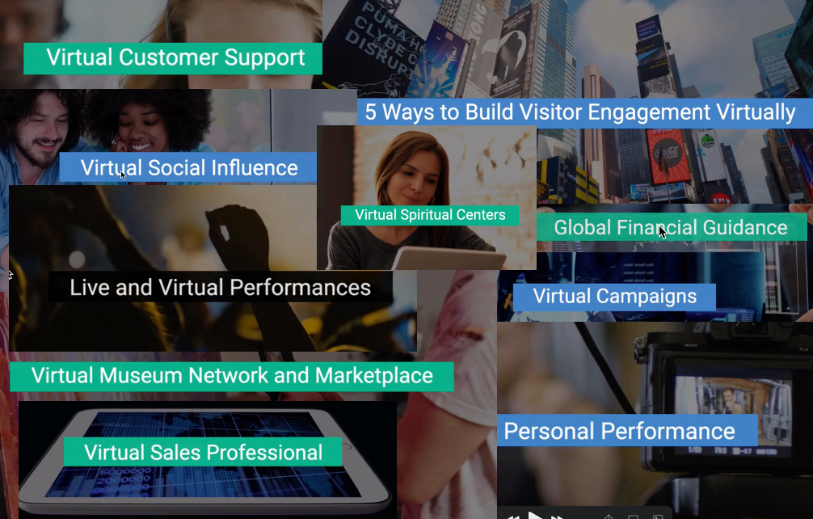
Videos for Key Use Cases
Email for links available on Linkedin
© SocialStreamingTV.com

Slide 37
Thank for your reviewing this presentation.
Please visit SocialStreamingTV.com for articles, ideas and more
Contact Tom Cross cross@gocross.com 303-594-1694
accelerate your business presence globally & virtually
© SocialStreamingTV.com

Slide 38
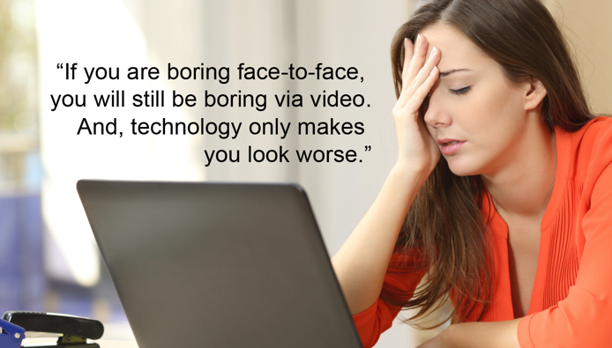
to Support Professional Education for Production of Live Streaming and Virtual Events
Professional Education Programs
© SocialStreamingTV.com

Slide 39
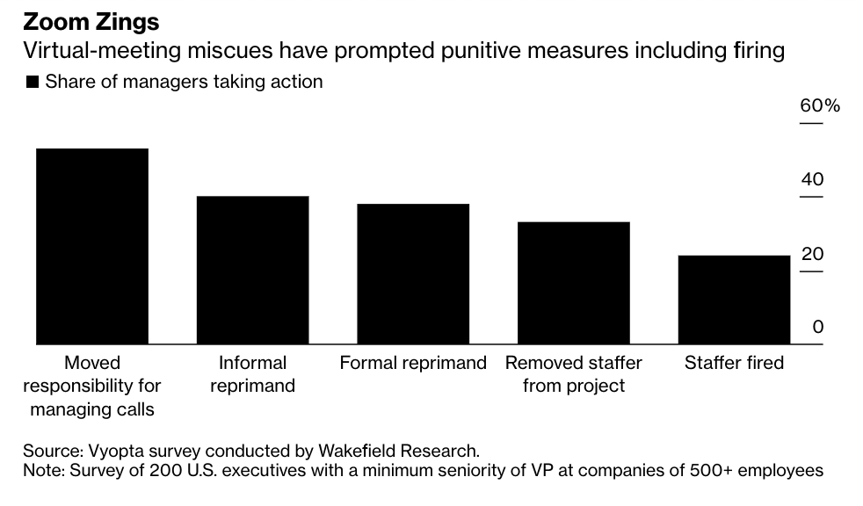
Benefits of Virtual Sales Professional Certification Program
Enterprise Sales Acceleration – B2B Professional Development Program
Proven sales revenue acceleration across thousands of B2B sales professionals that:
Reduces sales cycle
Increases competitive edge
Reduces staff turmoil and turnover
Produces higher margins
Provides improved sales leadership
STOP getting fired because you blunder
© SocialStreamingTV.com

Slide 40
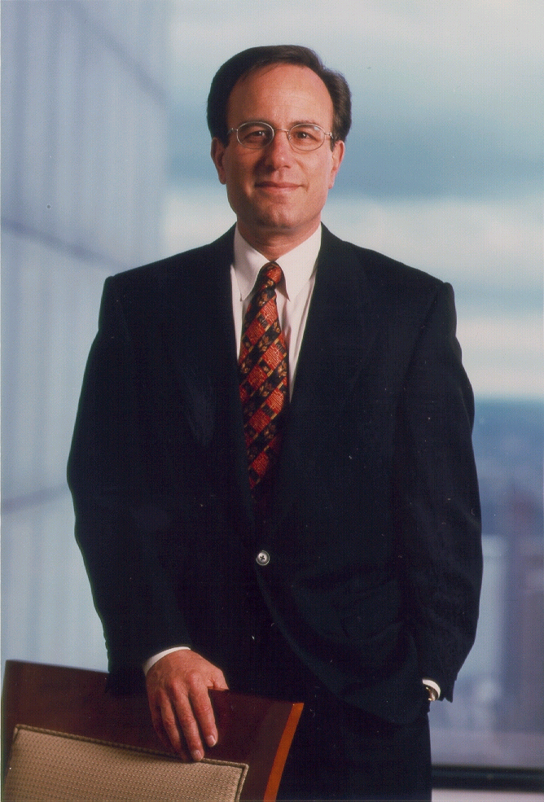
Enterprise Virtual sales Professional Certification acceleration goals
Presents enterprise solutions selling scenarios.
Understand what customers especially enterprise business customers are looking for and expect from a provider of integrated applications solutions and networking services.
Understand what are the situations, success factors and solutions in making the sale and how you can make a difference in your prospective and ongoing customer relations.
And, most importantly, maximize the confidence-to-close factor and the customer gain-retain ratio.
“Confidence is a demonstration of knowledge.”
Ivan G. Seidenberg
Former CEO Verizon
© SocialStreamingTV.com
Notes:
As you may have seen by now, our vision statement is “building confidence through knowledge.” It reflects our view that the ultimate goal is to provide tools that give students knowledge to give them confidence in their ability to provide solutions for their customers.
Present solutions selling scenarios.
Understand what customers especially small-to-medium size business customers are looking for and expect from a provider of integrated data and networking services.
Understand what are the situations, success factors and solutions in making the sale and how you can make a difference in your prospective and ongoing customer relations.
And, most importantly, maximize the confidence-to-close factor and the customer gain-retain ratio!!!

Slide 41
Virtual Sales Fundamentals Professional Certification
Fundamentals of Virtual Selling for Professional Selling Professionals
Session 1 – Customers Bane or Boon ~1 Hour
Session 2 - Building Strategic Customer Assessments ~1 Hour
Session 3 – Taking Virtual Selling Action Today ~1 Hour
© SocialStreamingTV.com

Slide 42
Virtual Sales leadership Professional Certification
Leadership Level - Virtual Selling for Corporate and Sales Leadership
Session 1 – Selling Virtual Selling to the Organization – The Hardest Part ~1 Hour
Session 2 – Critical Virtual Selling Concepts ~1 Hour
Session 3 – Corporate Management and Virtual Selling ~1 Hour
Special Session - Building a Virtual Selling Corporate Strategy
© SocialStreamingTV.com

Slide 43
Virtual Sales EXPERT Professional Certification
Expert Level Sessions: QUEST for Accelerating Enterprise sales
Note: Expert Level is a multi-session program
Questions, Understanding, Evaluating, Systems-Support and Teaching
Session 1 - Top-10 Personal Sales Professional Criteria
Session 2 - Top-10 Enterprise Sales Opportunities for Cloud, SD-WAN, UC, Collaboration, AI, Pandemic Tech and Emerging Tech
Session 3 - Top-20 Enterprise Customer Types
Session 4 - Top-10 Key Criteria for Enterprise Sales Meeting/Presentation
Session 5 - Top-10 Enterprise Proposal Guide
© SocialStreamingTV.com

Slide 44
Virtual Sales expert Professional Certification
Expert Sessions - Continued
Session 6 - Top-10 Enterprise Business Issues
Session 7 - Top-10 Enterprise Technical Issues
Session 8 - Top-10 Enterprise Network Management Issues
Session 9 - QUEST - Questions, Understanding, Evaluating, Systems-Support and Teaching
Session 10 - Customer Phases - Assessment, Analysis, Selection & Implementation
Session 11 - Optional Role Play – Customer Case Studies
Session 12 – Sales Manager Development for First Time, Team Turn Around and Accelerate Growth
Session 13 - Optional Certification Testing
Session 14 – “Personal Trainer” Coaching Service and App
© SocialStreamingTV.com

Slide 45
Virtual Teacher-Presenter Events-Meetings Professional Certification
Fundamentals 1-hour
Fundamentals of Virtual Events Technologies
Virtual Event technologies – video, audio, graphic and augmented and emerging tech including AI and more
Advanced Level ~2 hours
SEAL Team training – Speaker, Engagement, Audience and Logistics
Enhanced Virtual Events tech for Meeting Types
Expert Level ~2 hours
Advanced level discussion on high-level discussions including C-level presentations, investors, Wall Street Analysts, crisis communications and virtual trade shows
© SocialStreamingTV.com

Slide 46
Virtual Teacher-Presenter Events-Meetings Professional Certification
Virtual Event Producer ~1-hour
For large audience and special audience (museums, parks, music theatre, sporting) event productions.
Virtual Event Production ~1-hour
For those interested in building or remodeling a room or rooms for professional home video production technologies.
© SocialStreamingTV.com

Slide 47
Virtual Professional class evaluations
User evaluations:
“Leadership begins with great presentations, team building, collaboration and frankly being organized. The VEP Procert gave me all these tools and much more to be a better CTO leader.” J.L
“Meetings are the bane of my business, however, nothing gets done without them. I needed skills and ideas to make meetings and business communications faster, reducing costs and frankly, much better. VEP did that - thanks.” M.G CEO
”VEP is the best course for better management communications – period.” K.E
Vendor evaluations:
“The VSP class accelerates our conferencing and collaboration revenues reducing the sales cycle by demonstrating to our customers we are committed to user ‘driver training’ to help them make better presentation and use cases of our solutions.” D.T.
“I have been selling conferencing for a long time and so tired of hearing stories of the old conferencing system going unused because users aren’t really trained. That is, they try it and fail especially C-levels, the VSP course gives me a real competitive-edge showing we are committed to the customer now and in the future.” R.C.
© SocialStreamingTV.com

Slide 48
Virtual Professional class evaluations
"Tom and I developed and delivered more than a dozen virtual webinars on social media, virtual selling and marketing strategies. Tom is an excellent course designer, developer and importantly has great delivery and virtual presentation skills. I would highly recommend him for any virtual presentations including investor pitch, virtual selling, virtual events professional as well as highly technical subjects including AI.
His book on AI - MindMeld has been called the best book on AI yet written. He can really help you be your best."
Evan Kirstel #1 Social Media in AI, Retail Tech and many other B2B markets.
© SocialStreamingTV.com

Slide 49
Virtual Professional class evaluations
Tom has been involved in the Rockies Venture Club for many years at one time assisting us with our social media and insightful thought leadership blogs. He also attended many monthly meetings listening to hundreds of startup pitch presentations.
Tom and I team-taught the section in the RVC Hyperaccelerator program five times on Sales, Go-to Marketing and Marketing to more than 50 companies. We also share the critical concern that marketing is #1 cause of startup failure and success. Tom is a great course developer, engaging presenter and thought leader and would highly recommend his Virtual Event/Sales Professional courses to any startup, business or anyone wanting to make their business plan presentation to investors and others get "pitch perfect."
Peter Adams CEO Rockies Venture Club
© SocialStreamingTV.com
© UCXmarket.live

Slide 50
Thank for your reviewing this presentation.
A little more to help you get started
© SocialStreamingTV.com

Slide 51
Before we get started – let’s just discuss for a moment the #1 question people ask before doing video streaming – How do I do it ?
Here’s one answer to help you get started:
Our customer wrote this cool one-page article call Tech Tips - "Thinking Beyond the Webcam - "How to Do Build Your Own Video Network Easily for Hundreds, Not Thousands” by Steve Peckman - Founder - Eclipse Learning Partners
Steve wrote, The use cases for live streaming and on demand video are endless for live music concerts, theatre and dance performances, museum tours, outdoor sporting events, churches, business meetings and trade shows, corporate events and much more. But you will need some equipment to do it well and here’s one way, not the only way but a cool innovative way.
© SocialStreamingTV.com

Slide 52
To get started you can use a video mixing device such as the ATEM video mixing board that allows you to connect multiple HDMI sources and have them appear to your computer as one A/V device.
© SocialStreamingTV.com
© SocialStreamingTV.com

Slide 53
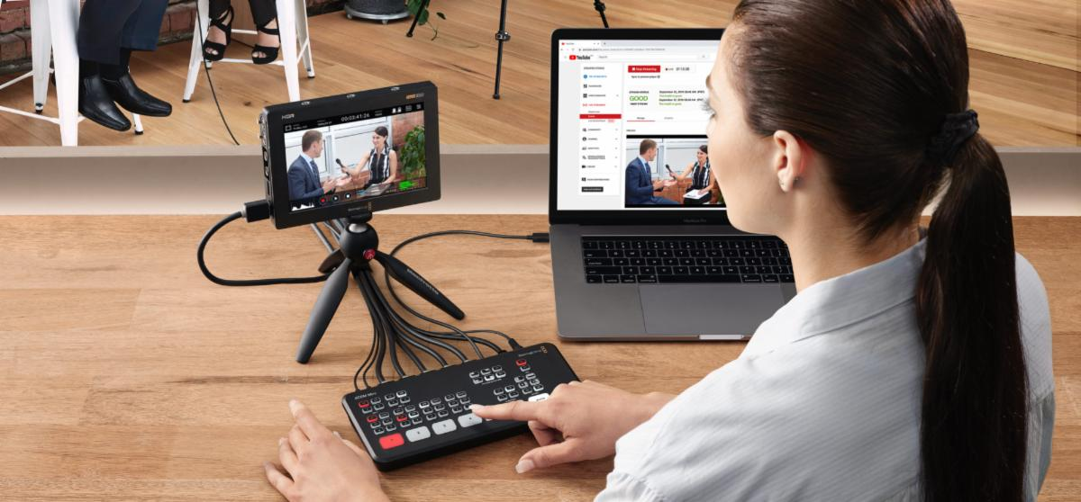
The ATEM Mini has 2 audio inputs, so you can connect the output of an audio mixing board into it.
© SocialStreamingTV.com
© SocialStreamingTV.com

Slide 54
Putting It All Together - Background
The ATEM video mixing board allows you to connect multiple HDMI sources and have them appear to your computer as one A/V device. HDMI sources can range from high-quality cameras, computers, iOS or Android devices with HDMI adapters, anything with an HDMI output. When it comes time to broadcast, you can select which camera is "on-air" and you can switch sources from HDMI-1 to HDMI-2 with the push of a button with a selection of transition fades as you would have with PowerPoint slide transition feature. The base model starts at just $295 retail with additional features like the ability to record directly to a USB hard drive and record multiple camera inputs as individual streams that you can mix later in DaVinci or similar video software, the price ranges upward. For $995 the Mini Extreme, get 8-HDMI inputs, 16-way multiview, 4 ATEM Advanced Chroma key, SuperSource with 4 extra DVE's, 2 HDMI outputs, 2 USB ports and a more powerful control panel which I believe is a breakthrough price point for the featureset.
The ATEM Mini has 2 audio inputs, so you can connect the output of an audio mixing board into it. There is a software audio mixing board within the ATEM which is controlled from your Mac or PC via a USB-C connection, so you can mix the sound from the audio ports and the HDMI sources. Not only can you use this instead of your webcam when you broadcast with SSTV, but the ATEM Mini also streams directly to Facebook, YouTube, etc.
Click here for the complete one-page article and contact information for Steve and get him to help you amp up and ramp up your video streaming efforts.
© SocialStreamingTV.com

Slide 55
© SocialStreamingTV.com

